Slide 1
VTC
2025 Travel Trends
February 2025

Slide 2
RESPONSIBLE TRAVEL & SUSTAINABILITY
Travelers are taking action as a response to overtourism. Consciously traveling during off-peak times to less popular destinations are ways in which travelers hope to preserve cultural heritage and the local environment.
There is an increasing interest in eco-friendly adventure activities like hiking in protected areas, kayaking in pristine coastal regions, and participating in conservation efforts as part of trip itineraries.
Rail travel is increasing in popularity as part of the immersive travel experience AND as a more environmentally friendly option.
A shift towards more ethical wildlife viewing practices and conservation-focused wildlife experiences.
Increasing popularity of volunteer opportunities related to wildlife conservation.

Slide 3
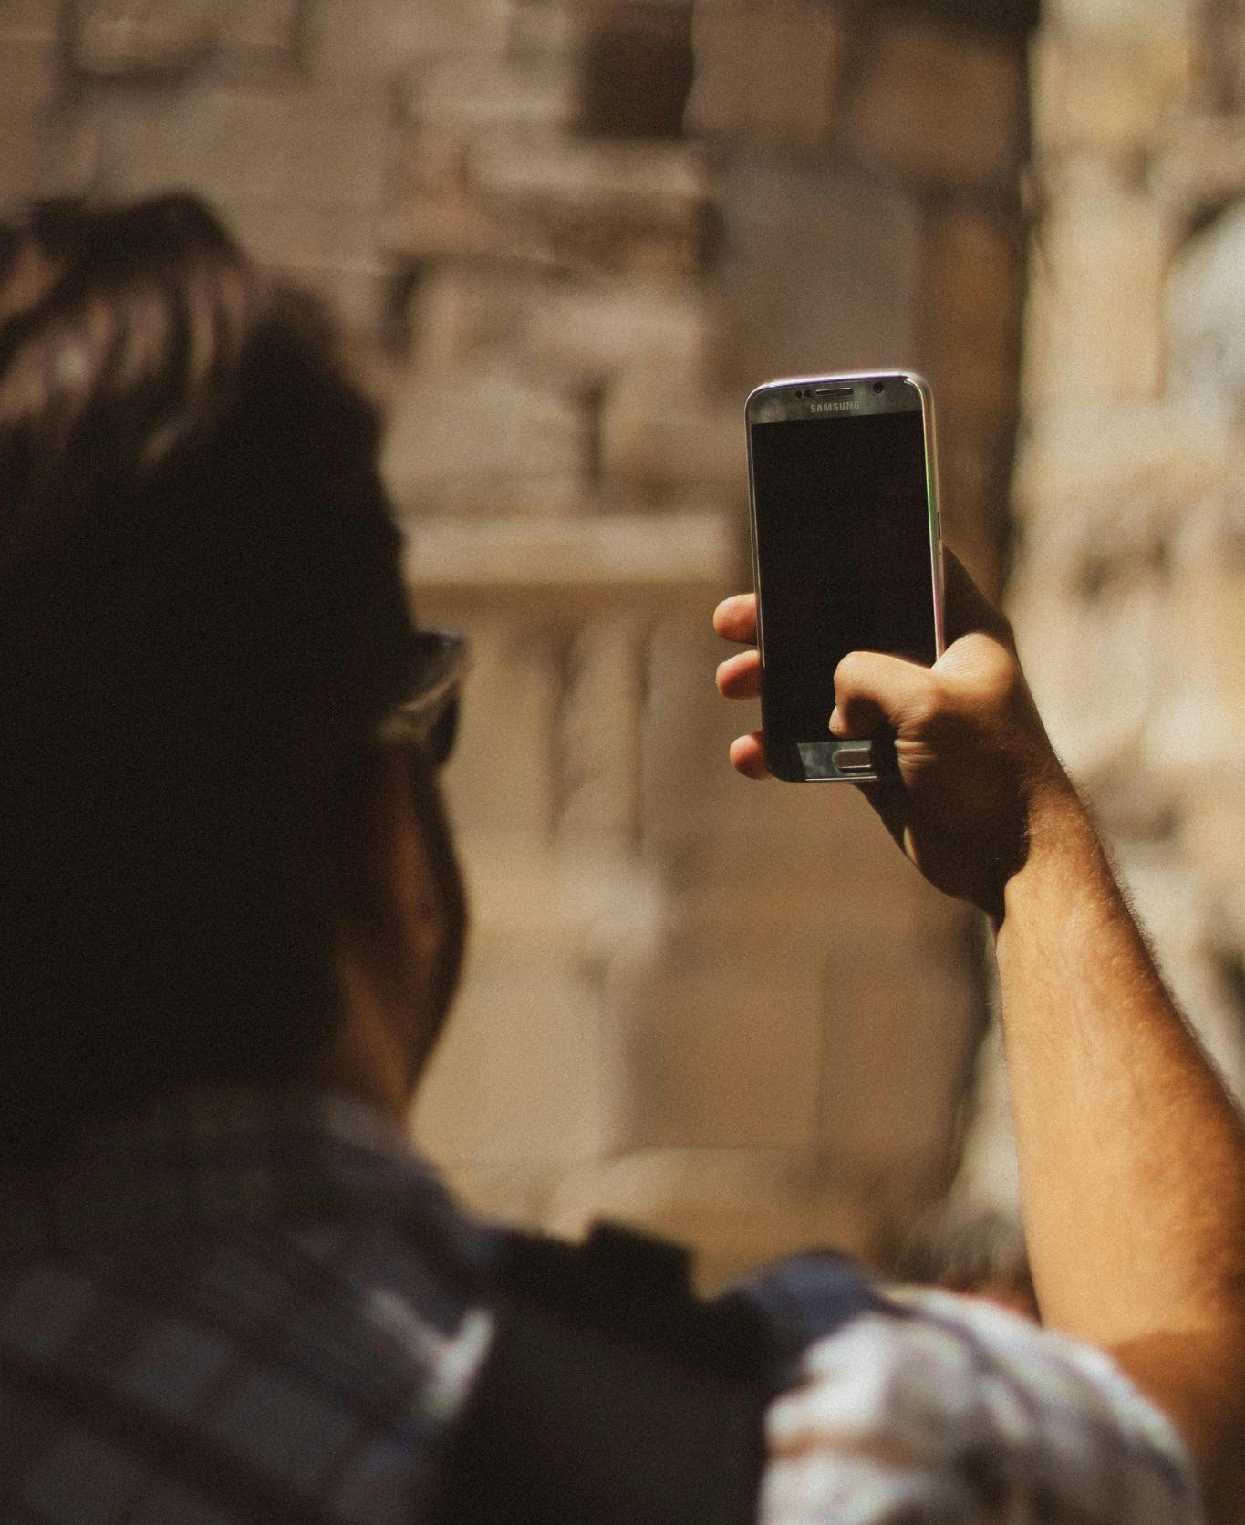
AI & TECH STREAMLINED EXPERIENCES
Travelers are offloading planning fatigue by using tech tools, apps, AI systems, or travel advisors to craft personalized trips.
Travel agents are incorporating more tech tools as a part of their planning processes.
Advances in generative AI, machine learning, and deep learning are not only redefining planning, but also the booking process and excursions/experiences.
Automation, both visible (like robots) and invisible (like AI-driven customer service), is becoming more prevalent in travel, enhancing efficiency and personalization. “Smart” hotel rooms and airports are on the rise.
Using tech for travel security with tools such as Blockchain is gaining momentum.

Slide 4
Solo & Multigenerational travel.
By 2025, seven generations will be traveling together for the first time in history, as “Beta Babies” are born to Gen Z parents. This includes Generation Alpha, Millennials, Gen X, Boomers and the Matures. XZ Beta Travel will see young Gen Z parents traveling with their children and Gen X grandparents, who often finance the trips.
Multi-generational travel gaining traction, with families reuniting for milestones, 32 percent of Gen Z planning to travel with children.
According to Virtuoso, 71 percent of its solo travelers are women, with 47 percent divorced, separated or widowed, highlighting a surge in post-partner or family-raising travel.
58% of global travelers who travel with their kids revisit destinations from their own childhood.
VTC 2025 TRAVEL TRENDS

Slide 5
Adventure travel.
Strong emphasis on once-in-a-lifetime experiences in 2025.
Travelers are embracing “F**k-It Lists” – spontaneous, fun and liberating adventures that prioritize living in the moment and fueling splurges on more extravagant modes of travel like yacht charters, first-class flights and private jets.
Adventure and exclusivity drive destination choices with a growing interest in off-the-beaten-path locations like Southeast Asia, Patagonia, and remote Mediterranean islands.
High demand for adventure sports, tailored experiences to destinations like Antarctica, and luxury cruises to remote parts of the globe.
7 in 10 global travelers enjoy being active during their travels.
1 in 5 leisure travelers are planning outdoor adventures in 2025.
Growing interest in deep, meaningful cultural interactions as part of adventure travel.
Rise in community-based tourism initiatives and cultural immersion programs.
VTC 2025 TRAVEL TRENDS

Slide 6
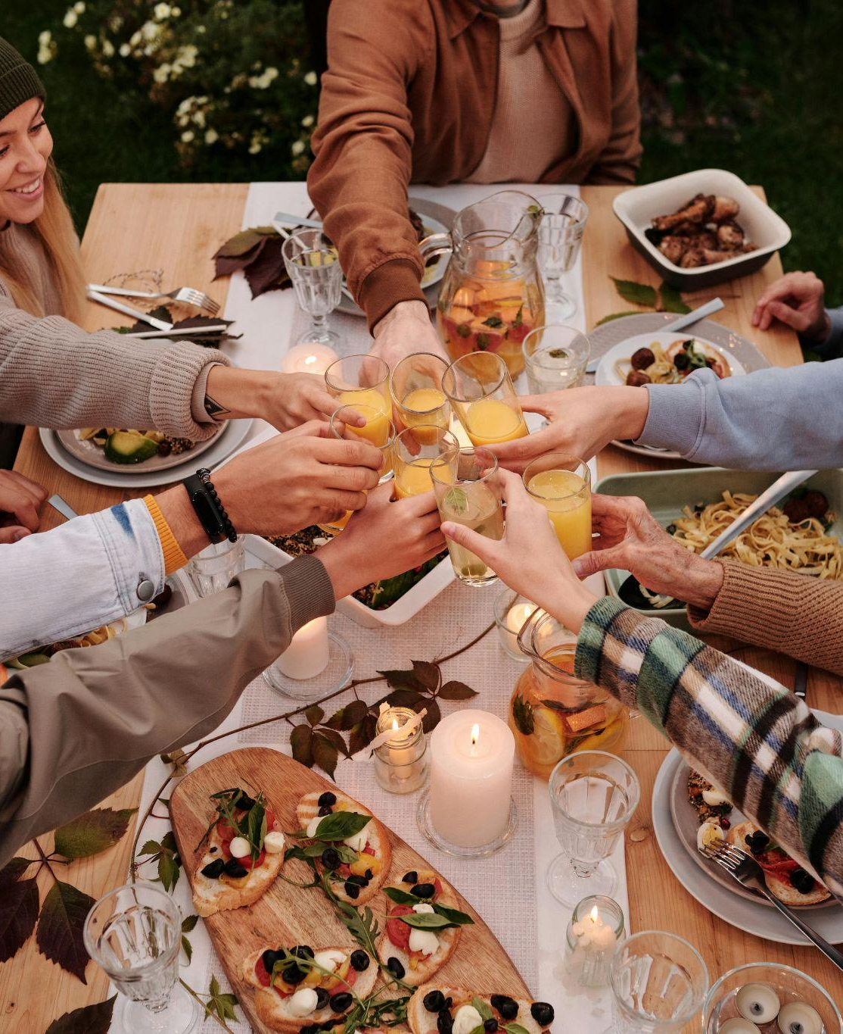
IMMERSIVE FOOD EXPERIENCES & TEMPO DRINKING
Travelers show a heightened interest in local culinary experiences, including local eateries over chains, farm-to-table restaurants, and hands-on cooking classes with local hosts.
Nearly 1 in 5 global leisure travelers seek new culinary experiences, with 50% booking restaurant reservations before their flights.
1 in 4 global travelers has either reduced or stopped their alcohol consumption, reflecting the Tempo Drinking trend.
Preference for private dining and staying in private homes or small, locally-owned restaurants that offer a connection to local life and fresh regional dishes.
Food tours that offer insights into a destination's culinary heritage, engaging with local vendors, and tasting regional specialties are popular.
VTC 2025 TRAVEL TRENDS

Slide 7
ASTRO ADVENTURES/PHENOMENA LIST
Northern Lights, Dark Sky Parks, Solar Eclipses, Stargazing, and other space/sky related tourism continues to grow.
The astro adventures trend also refers to the rise of astrology-led travel, and people seeking a sense of connection with the cosmos. Younger Gen Zs and Millennials in particular are increasingly turning to the stars for their upcoming travels, with 44% of the 25-34 year olds surveyed by Skyscanner saying they were interested in using astrology to determine their next trip.
Survey data revealed that the Northern Lights (61%) are the top phenomenon travelers want to see, followed by geological phenomena (30%) like volcanoes, geysers and hot springs.
VTC 2025 TRAVEL TRENDS

Slide 8
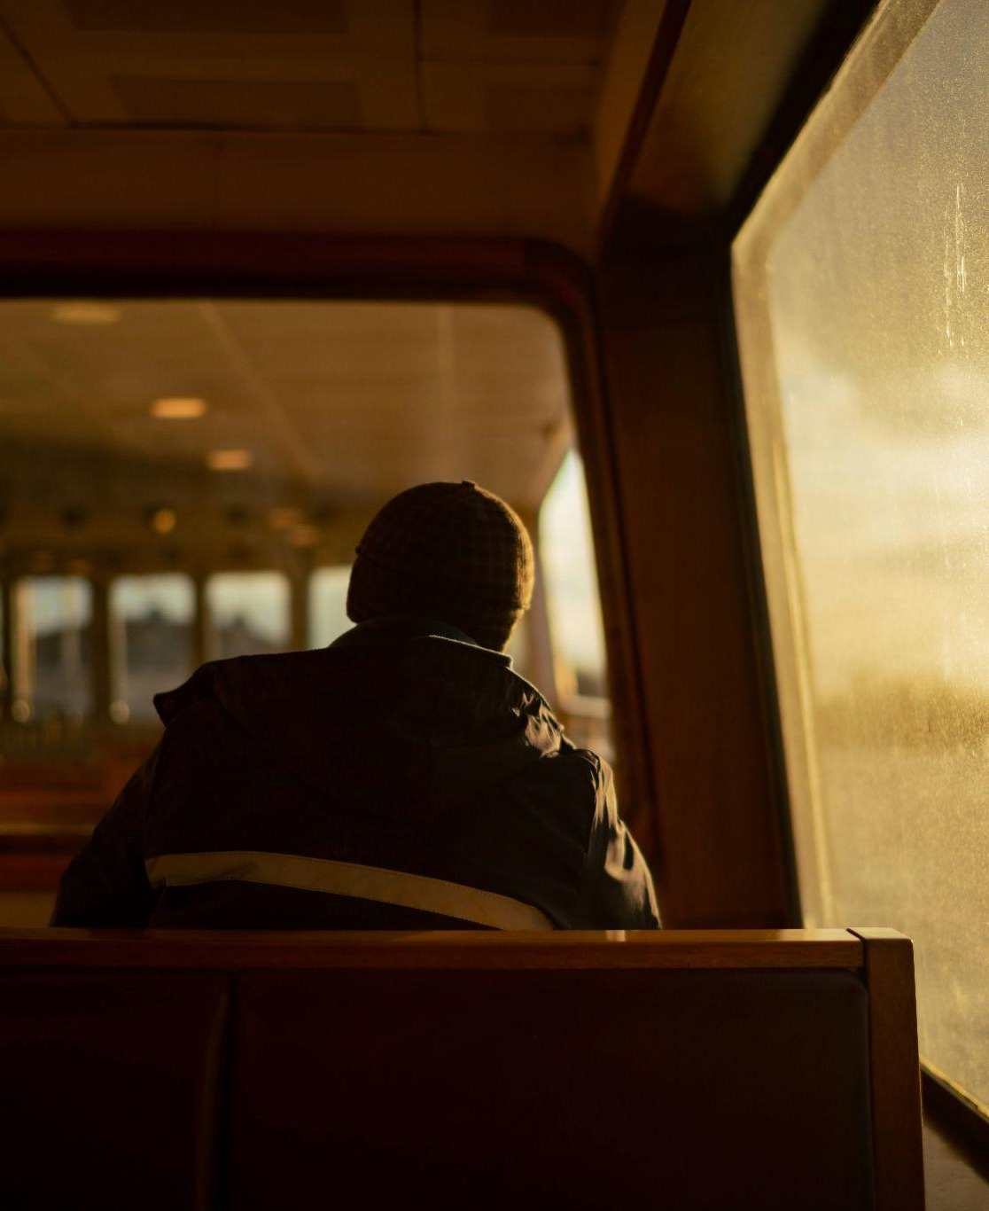
QUIET TRAVEL/ “JOMO”: Joy Of Missing Out
Botanical gardens, nature retreats, solo holidays, walking tours, bird watching, etc.
Today's all-inclusives are attracting Gen Zers who are looking for stress-free stays and a good deal. One-third of Gen Z travelers said their perception of all-inclusive hotels has changed for the better and 42% say an all-inclusive resort would be their preferred hotel type
The top three reasons Gen Z is embracing their All-Inclusive Era are minimal stress (41%), ease of booking (39%), and because staying at all-inclusive hotels feels luxurious (38%)
New “Horti-Culture” trend: Horti-culture means placing gardening and a return to nature at the forefront of travel plans
1 in 5 global travelers indulge in "Hurkle-Durkling" (lounging in bed all day) while on vacation.
More than a quarter of travelers will book a spa or wellness treatment to enhance their sleep.
More than 1 in 5 travelers plan leisure getaways for self-discovery or mental health, leaning into "Soft Travel."

Slide 9
SOCIAL MEDIA
TikTok is leaning harder into travel after data showed the platform has become a key tool for users to discover new destinations, build itineraries, and even buy plane tickets.
TikTok reports that 83% of users find travel destinations they hadn’t considered before on the app, with 60% following through on actually visiting them.
67% of TikTok users purposely search for travel experiences on the platform, which ensures that their For You page keeps recommending more travel content.
Interestingly, while Gen Z is creating the most travel content, users over 45 are the ones watching the most content. It’s cross-generational.
Though shopping on Instagram and TikTok has become the new normal for lower-ticket items like fashion and beauty, travel shopping on social media is still in its early stages. Half of consumers say they have wanted to book a trip they saw on their social feeds, but cited time and complexity as the primary barriers. Expedia recently launched travel industry-first shoppable storefronts curated by social media creators, tastemakers and brands with more than 100 Travel Shops live on the Expedia app.
Travelers are looking for “bragging rights and social media-worthy content” from lesser-known places.

Slide 10
THANK YOU!
A full bibliography can be found here.
VTC 2025 TRAVEL TRENDS

