Slide 1

BUSINESS DEVELOPMENT
New Funding ─ New Product ─ New Visitors
Notes:
Business Development falls under our PARTNERSHIP MARKETING division at VTC

Slide 2




TDFP
TZONE
TID
VISITORS
Notes:
Business Development covers (4) key areas:
TDFP Tourism Development Financing Program
TZone Tourism Zones
TID Tourism Improvement Districts
Visitors New travelers to engage and increase visitor spending in VA

Slide 3
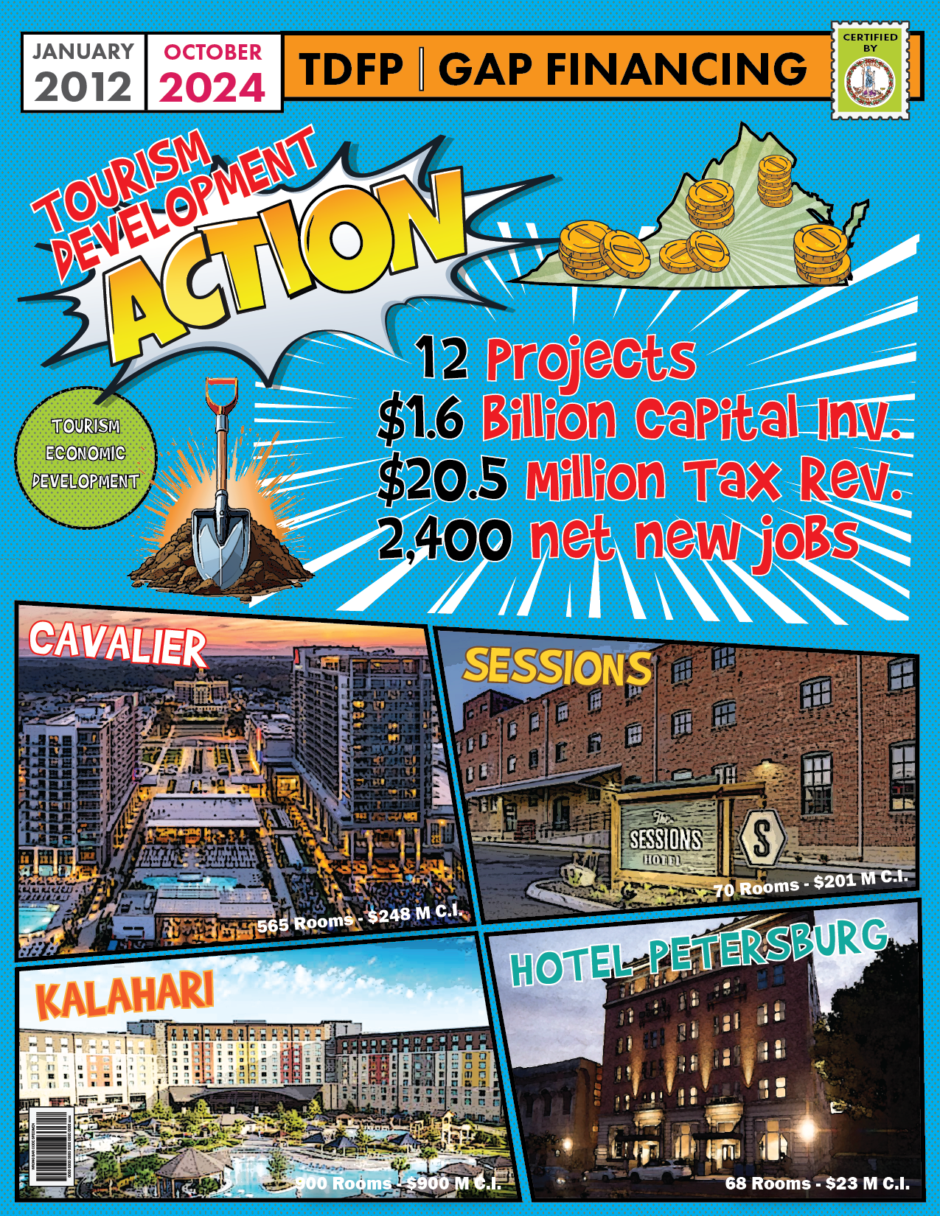
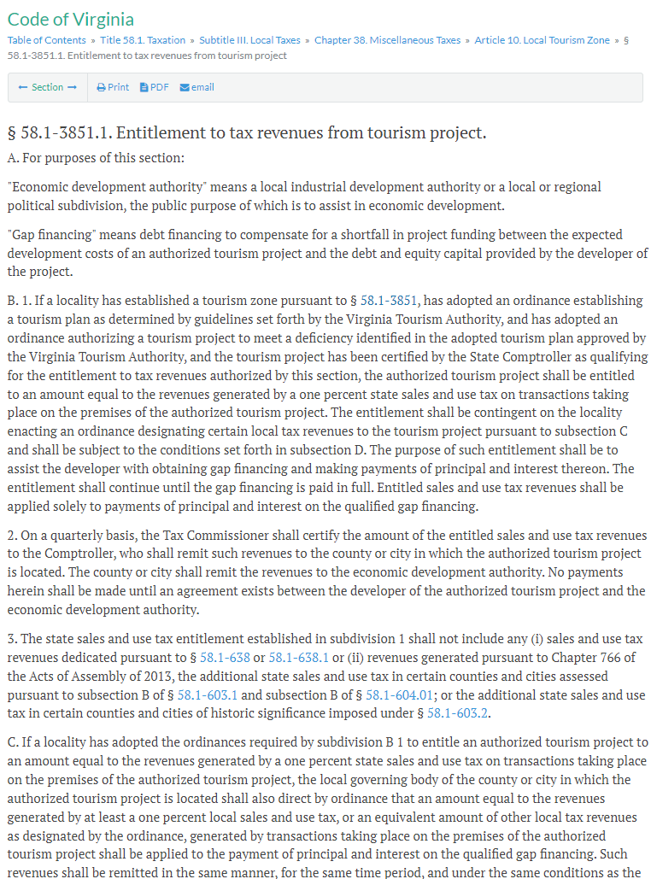
Notes:
The TDFP / Tourism Development Financing Program was created and written into VA Code in 2011 by the General Assembly
Its main purpose is to support filling deficiencies in tourism product (mainly lodging) where visitor demand is high
To identify where product development is needed and to support the funding for these key, larger-scale projects
* Click to fade in next image on this slide > the “Tourism Development in ACTION”
Rather than read the code together (quite daunting ☺ ) let’s look at the exciting results that TDFP has brought to VA
From 2011 to 2024 …
* Read projects and results on the graphic

Slide 4

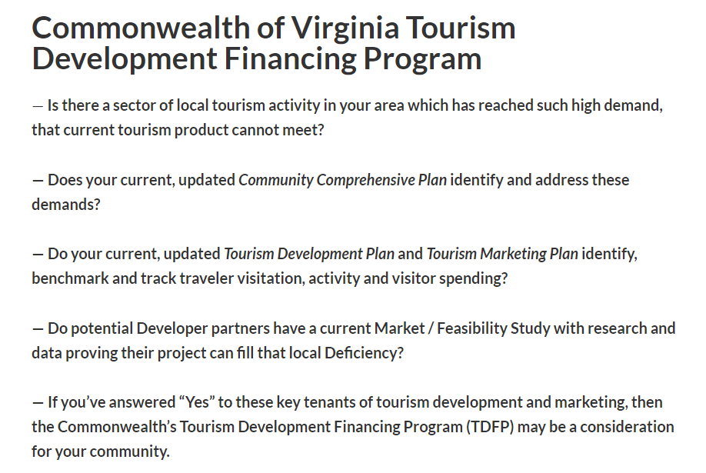


✔ Areas with High
Visitor Demand
X Areas with Med
Visitor Demand
X Areas with Low
Visitor Demand
Notes:
TDFP is not for project development with low or med visitor demand
It is specifically for areas that through data and research prove a high visitor demand not currently met
— Is there a sector of local tourism activity in your area which has reached such high demand, that current tourism product cannot meet?
— Does your current, updated Community Comprehensive Plan identify and address these demands?
— Do your current, updated Tourism Development Plan and Tourism Marketing Plan identify, benchmark and track traveler visitation, activity and visitor spending?
— Do potential Developer partners have a current Market / Feasibility Study with research and data proving their project can fill that local Deficiency?
— If you’ve answered “Yes” to these key tenants of tourism development and
marketing, then the Commonwealth’s Tourism Development Financing Program (TDFP) may be a consideration for your community

Slide 5

?
30%
70%
Notes:
How does TDFP Gap Financing support work?

Slide 6
1
< $100 m
$ 112 k = Year Gap Payment
$ 30 k = Dev + Local + State
⎯ But for TDFP … the project halts
⎯ Developer secures 100% of the financing
⎯ New Tourism Development
⎯ New Jobs
⎯ Low Liability … No revenue? State stops $
⎯ Hub & Spoke Multiplier … visitor spend
⎯ Potential new TID partner
1% —
$ 10 k = Qty. Revenue
$ 1 m = Qty. Revenue
30%
Gap
Lender
70%
Developer
Equity + Debt
Notes:
Using Tier 1 projects as an example, The Developer proves they have a minimum of 70% of the financing, but can’t get the final 30% from their ‘First Tier’ Lender
The Developer then shows they’ve acquired lending to cover that ‘30% Gap’ from a ‘Second Tier’ Lender
With all the financing in place, and a successful TDFP application certified by the State Comptroller, the project then begins construction
Once open and generating revenue, the EDA (applicant) works with VA Dept. TAX
to identify the amount of ‘Quarterly Revenue” from the project
Then, identify a number equal to 1% of that revenue
That number equal to 1% of quarterly revenue is amount each partner contribute quarterly to the Developers debt with the Lender
Thus, each partner pays the same amount toward project debt that quarter
Partners = Developer / Locality / State
This process continues until the ‘Gap Debt’ is completed

Slide 7

1
2
3
< $100 m
> $100 m
> $500 m
$ 112 k = Year Gap Payment
$ 180 k = Year Gap Payment
$ 240 k = Year Gap Payment
$ 30 k = Dev + Local + State
$ 45 k = Dev + Local + State
$ 60 k = Dev + Local + State
1% —
$ 10 k = Qty. Revenue
1.5% —
$ 15 k = Qty. Revenue
2% —
$ 20 k = Qty. Revenue
$ 1 m = Qty. Revenue
$ 1 m = Qty. Revenue
$ 1 m = Qty. Revenue
30%
20%
30%
Lender
Gap
Gap
Gap
Lender
Lender
80%
70%
70%
Developer
Equity + Debt
Developer
Equity + Debt
Developer
Equity + Debt
Notes:
Here are examples of the ‘3 Tiers’ which potential projects fall under
You’ll notice different levels of secured and gap financing allowed

Slide 8
TDFP Definition + Scope
⎯ Supports a Developer’s gap financing
⎯ Much like a Tax Rebate or Tax Increment Financing ‒ contribute future sales tax revenues towards Developer’s project
X Not an upfront incentive
X Not a grant
X Not part of developer’s business loan
X Not for renovations to operating businesses
X Not for projects already under constructinon
⎯ Developer secures 100% of the financing in advance to complete the project
⎯ Performance Based ‒ State and County contributions begin when project is generating revenue
⎯ Project Focused ‒ Does not include surrounding businesses or industries
⎯ Low Liability ‒ If the project ceases revenue generation for any reason, neither State nor County contribute further

Slide 9
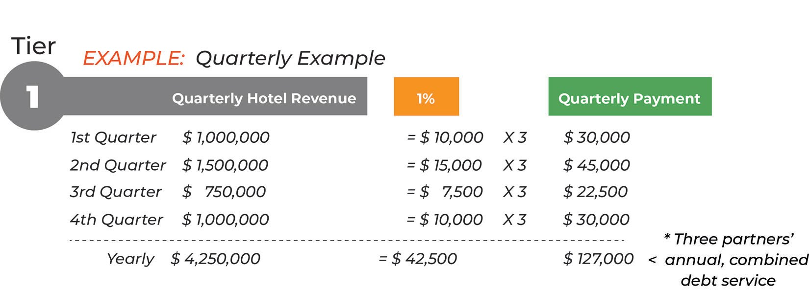
Example of
Quarterly
Payments
Notes:
…

Slide 10
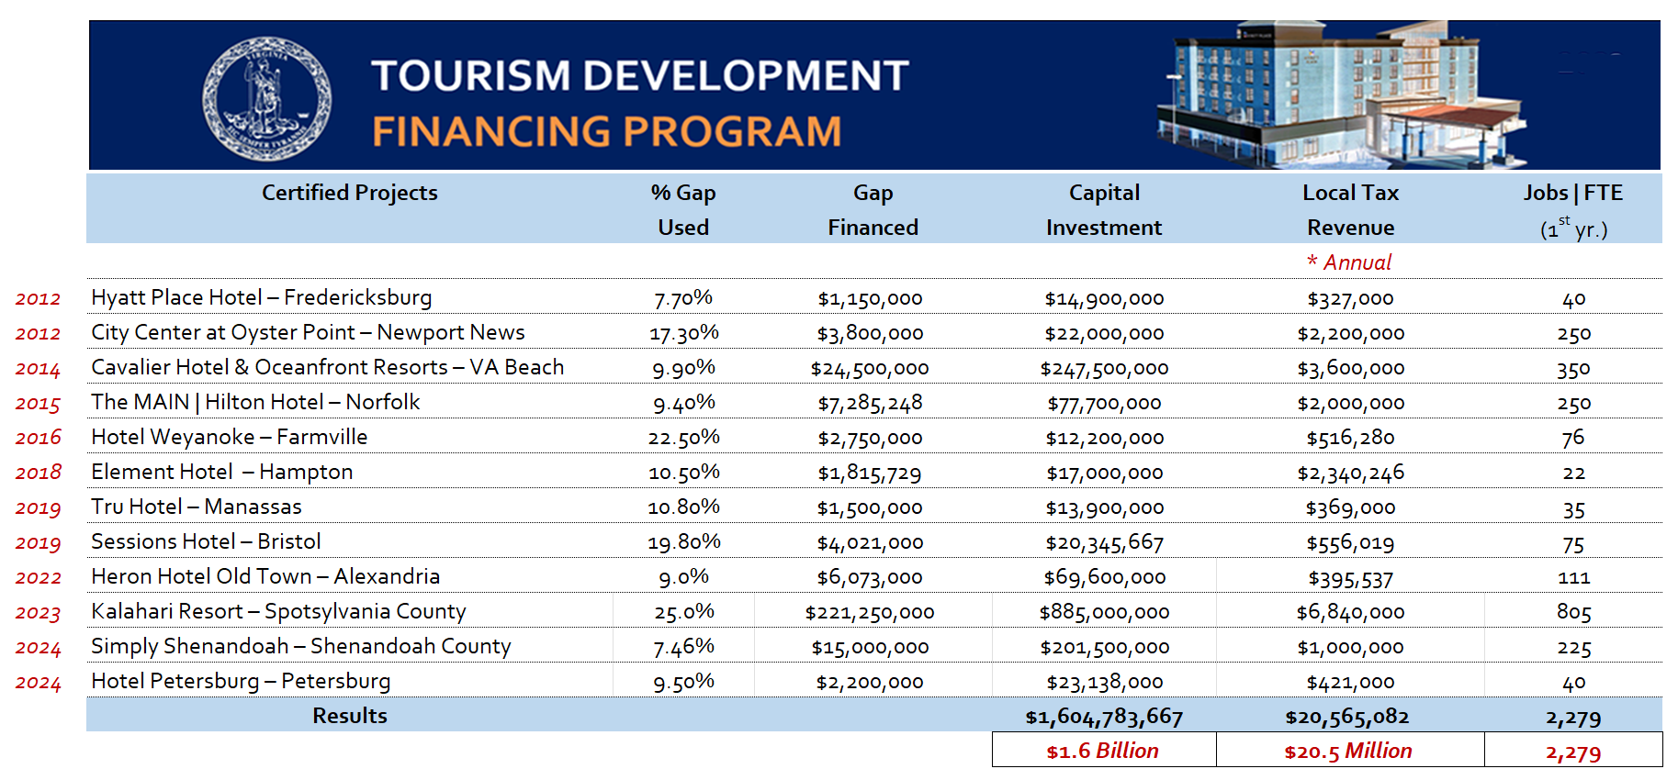
TDFP │ Certified Projects

Slide 11

70%
100% Financing
DEFICIENCY
Comprehensive Plan
Tourism Development Plan
Tourism Marketing Plan
Current Market Study
Tourism Zone
Increment Financing
Municipality, State and Developer collect and contribute future fee revenues towards the Developer’s debt with the Lender

Slide 12
TZONE

Slide 13
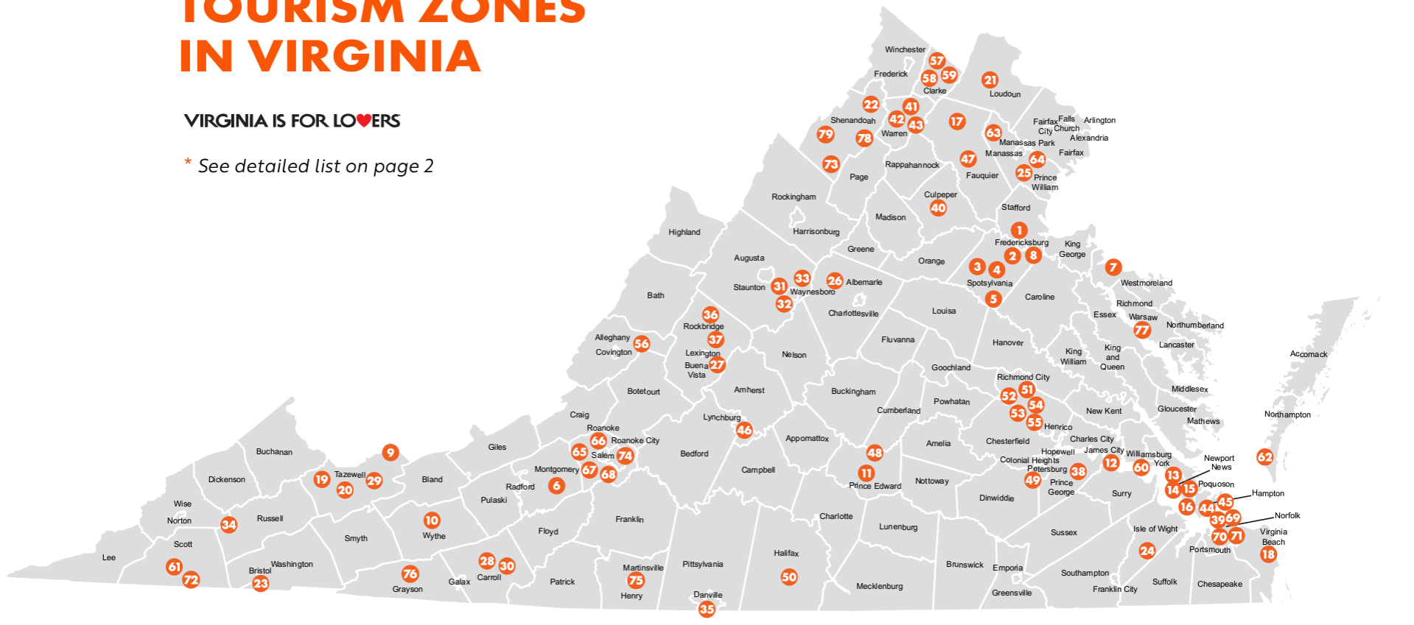
Tourism Zones in Virginia
VATC.org/tourismzones
Notes:
I’m going to change gears here for a minute and talk zoning
First, ‘Tourism Zones’ which area great tool for furthering tourism development in your community
Separate from TDFP, these zones help incentivize existing tourism businesses in a community – e.g. lodging, dining, retail, attractions, outdoors, experiences
Without any State management, a Locality can create their own zone and subsequent incentives for businesses that meet locality-specified revenue, tax revenue and job thresholds
These incentive can be changed to increase benefits to recruit new business

Slide 14

Notes:
A locality can create several different Tourism Zones to accommodate different areas travelers visit and spend the most

Slide 15
Notes:
Or create one zone for the entire area, which includes and incentivizes all tourism business in the area

Slide 16
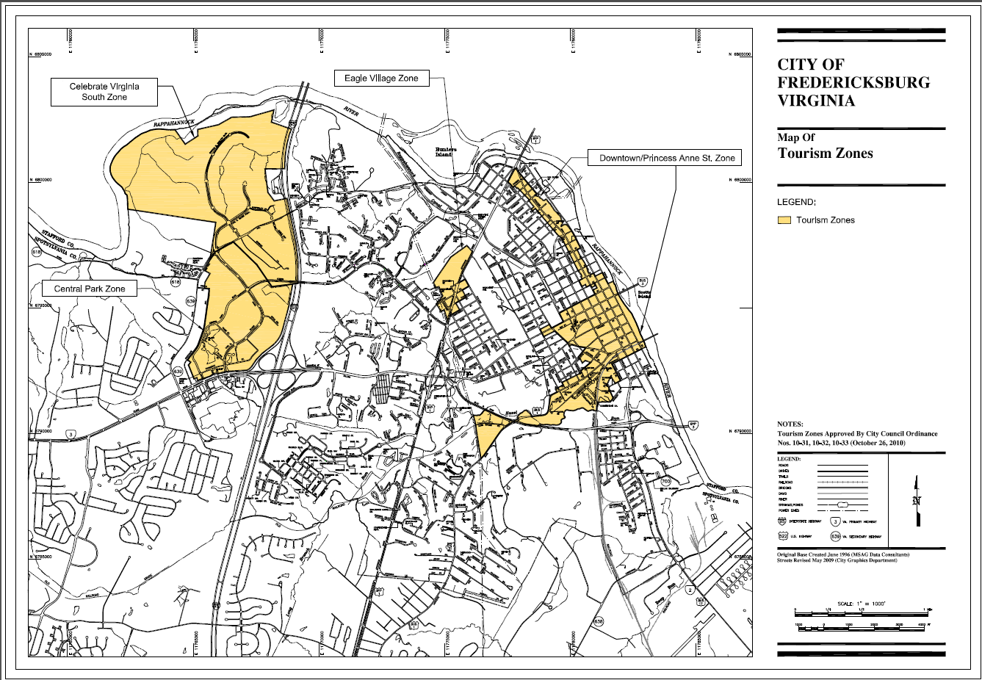
Notes:
Fredericksburg is a great example of a community who has fully taken advantage of tourism zones
They have 3 zones, all targeting different types of development

Slide 17
TID
Notes:
I’m now going to speak about ‘Tourism Improvement Districts”

Slide 18
Tourism Improvement Districts
A business district created to increase revenue
for destination marketing & capital investment
Tourism businesses collect new visitor fees to
fund local tourism marketing & development
Notes:
These are new to Virginia as of 2022

Slide 19

Notes:
Initiated and created by lodging partners with steady, year-long overnight spending, a Zone is created when lodging partners petition to collect a new ‘Visitor Fee’ (different than a tax)
This fee is collected and combined to fund new marketing, capital improvements and more for the areas the lodging partners are located
As an example, this graphic shows highlighted hotels that will participate with 70+ rooms, while the greyed-out areas decline to participate

Slide 20
Notes:
While the founding partners / participants are usually hotels, local dining, retail and attractions can collect the visitor fee right for the scale of their business, and contribute
As an example, this graphic shows highlighted hotels that will participate along with some local dining, retail and attractions
They each decided on a visitor fee to add to their reciepts and contribute to the TID

Slide 21
Notes:
A TID can be one, large are comprised of all those type of businesses aforementioned

Slide 22

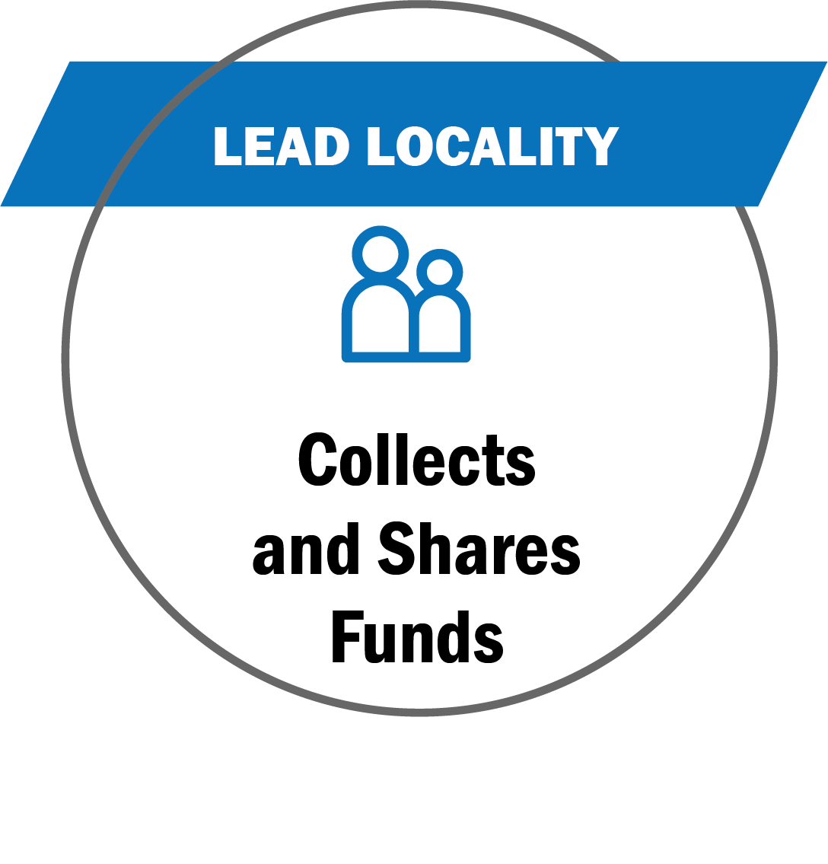
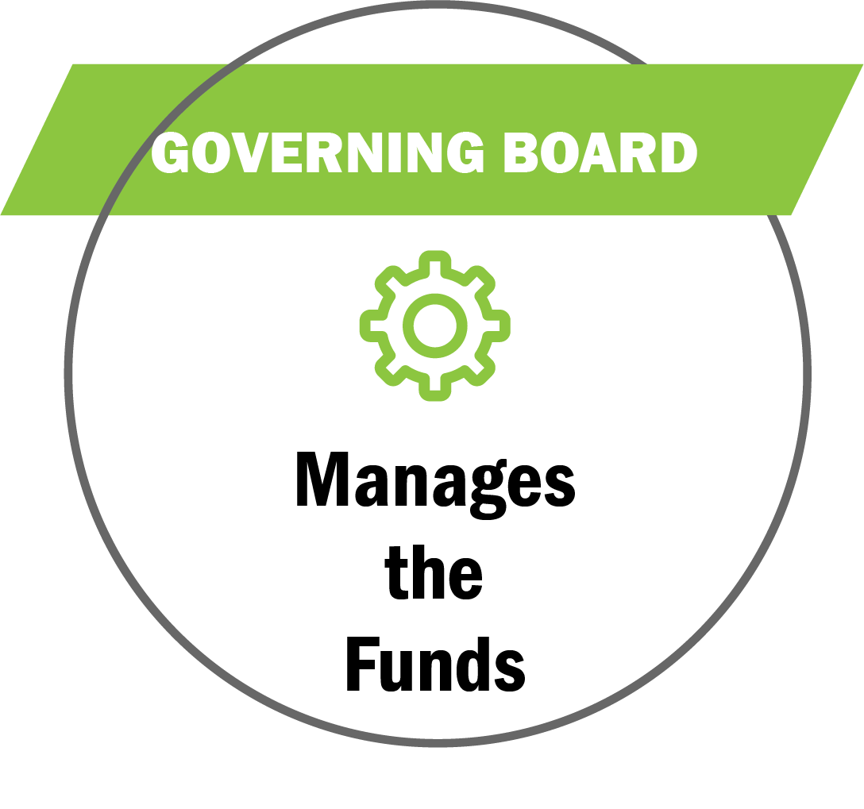
Benefited Businesses
Tourism Businesses
Initiates TID interest from local tourism businesses (hotels, restaurants,
attractions, etc.)
Collaborates with Locality to develop TID boundaries, eligibility, requirements and plan
Petitions Locality to create and adopt TID plan
Leading Locality
Municipality containing TID
Holds public hearings to review and adopt TID plan
Approves petition to create TID program
Collects fees and remits them to the TID Governing Board
TID Governing Board
Governing Board over TID Plan
Directs the funds received from the participating businesses
Executes the marketing efforts based on the adopted plan
Oversees any changes to the TID Plan
Creates more marketing dollars for local tourism efforts and campaigns
* Multiple localities can form
a regional TID

Slide 23
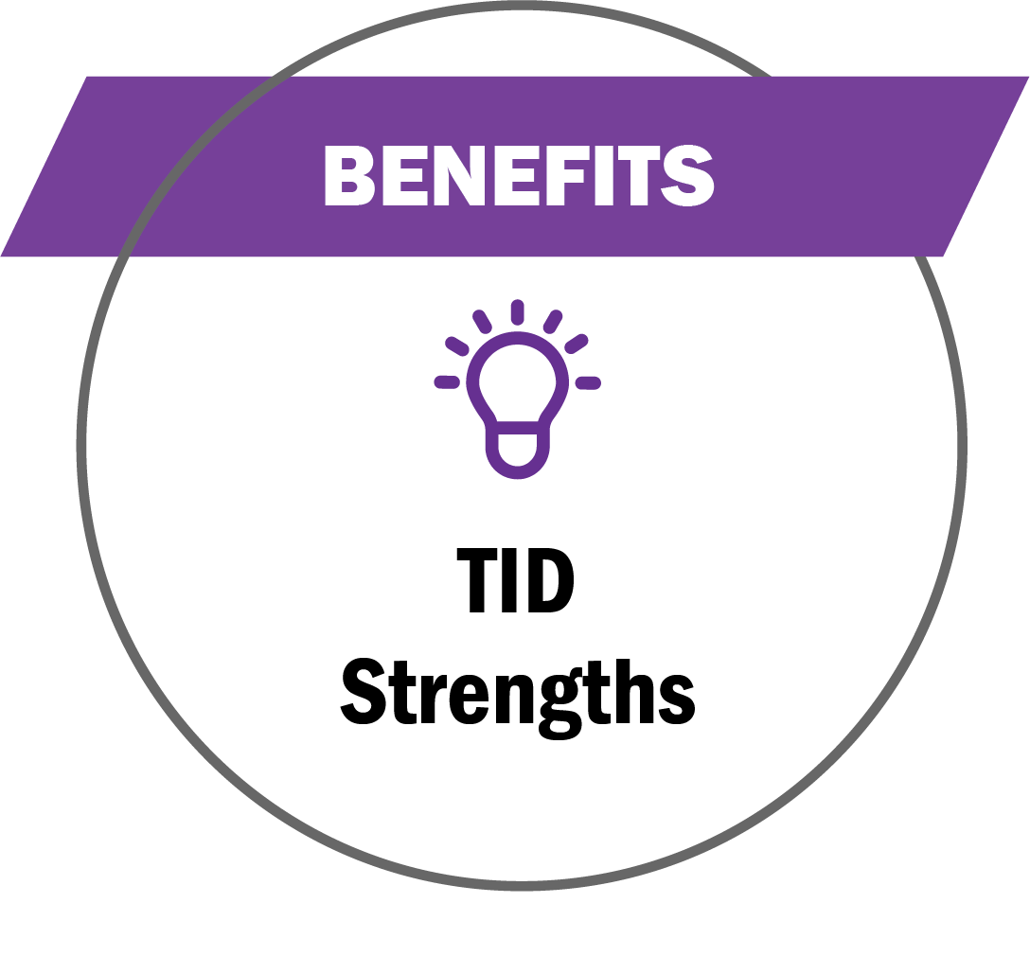
Grow & Leverage Tourism Funding
Stable and fixed funding sources for marketing efforts
Industry-led and privately managed and approved by stakeholders
Existing funding protected and new funding stays with the industry
Designed to increase longer stays and more visitor spending
Accountability and transparency
Mitigate the harsh impacts COVID-19

Slide 24
Fund Usage
Marketing, capital improvements, programming, workforce and DEI training
Sales site visits and events, group meeting incentives and bid fees, group commissions and rebates
Pay expenses to the Administering Nonprofit associated with the TID management and efforts

Slide 25
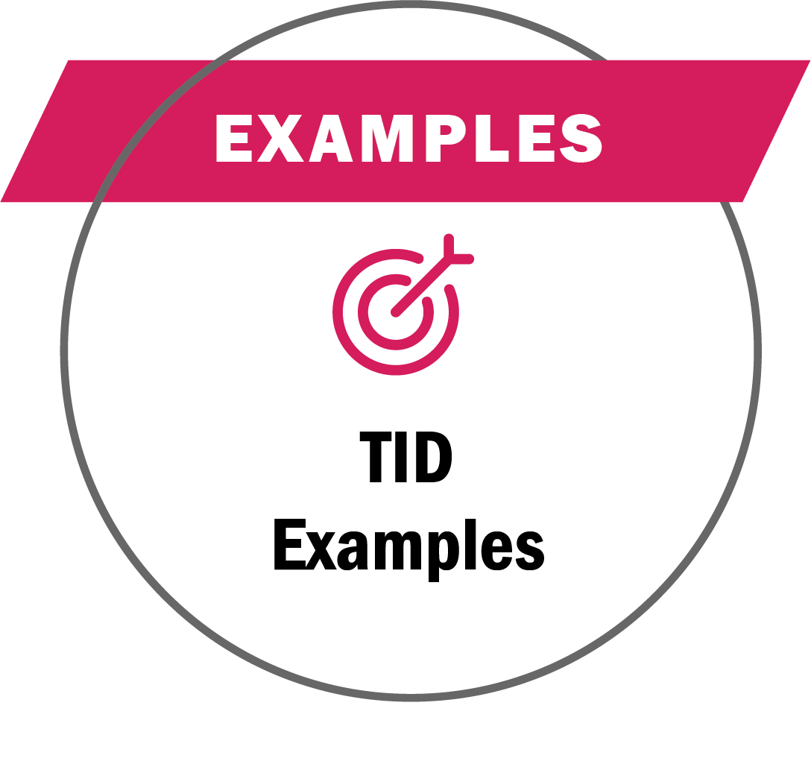


Benefited Businesses
Funding Examples
Lodging 70+ rooms add 2% room/night fee
Eligible = advertising costs, agency fees, production, printing, distribution costs, training, travel, printed material, promotional items, information technology, market intelligence, research, & performance audits
Benefited Businesses
Funding Results
.75% on room daily rate
Achieved ROI of 8:1 for funds allocated
$5.6 Million collected in their first year
92 Large conventions & events funded
Resulted in $1.6 Billion in economic impact

Slide 26
TID Zone
Town – City
County
TID Zone
Counties
Region
* Most commonly
Lodging, which creates
the maximum, substantial
volume and revenue
County A
County B
Lodging
Dining
Retail
Attractions
Wineries
Distilleries
Cideries
Breweries
Meaderies
Notes:
To recap …
A locality can have 1 Zone ⏐ Different Businesses Contribute
TIDs are primarily created with lodging/hotels as the lead partners
They have the visitor spending levels and frequency to establish and collect new visitor fees
Other tourism business sectors such as dining, retail and attractions can contribute if the local business community is unified
A locality can have 1 Zone ⏐ Specific Businesses Contribute
Businesses representing specific business sectors can collaborate and petition for a TID
A TID plan with only lodging, wineries, distilleries, cideries; or, restaurants or certain types of attractions can be created
Those benefiting businesses would collaborate, create their TID zone boundaries and plan
Then, petition the local government to adopt and pass the TID plan (as with the example above)

Slide 27

Zone
Town
City
County
Richmond City * managing non-profit
Ashland Town
Chesterfield Counties
Hanover
Henrico
Lodging
The Richmond Region recently approved a new Tourism Improvement District (TID). The TID is expected to generate as much as $8.2 million annually to support the promotion of the region as a leisure, conference and sports tourism destination.
Notes:
Richmond Region Tourism is the first, and currently only, TID in Virginia
It is comprised of the current, regional tourism partners
Each locality passed local ordinances agreeing to participate in the TID, and to collect the funds from participating hotels to give to the TID Governing Body
The funds are then used regionally

Slide 28
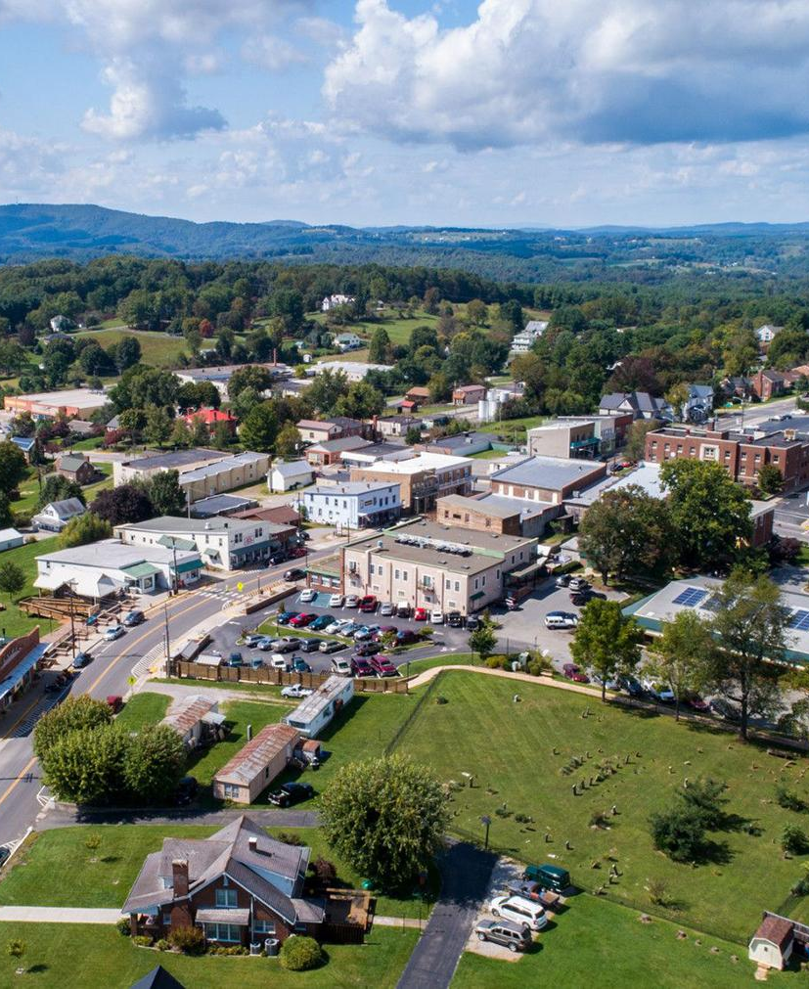

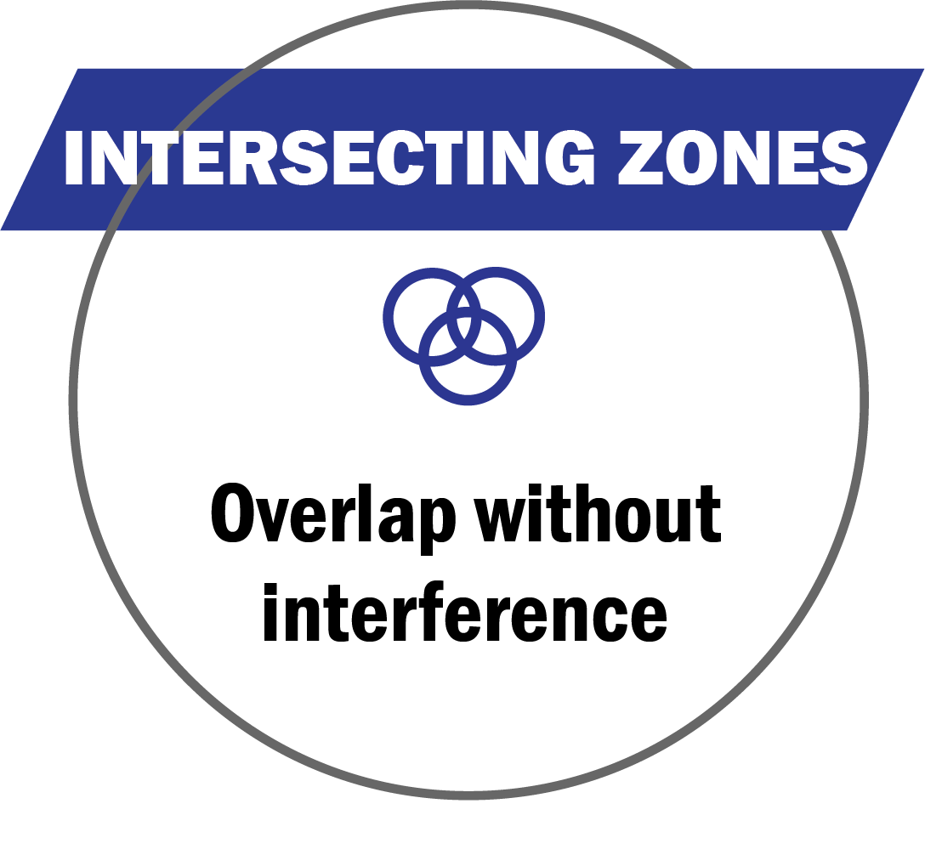
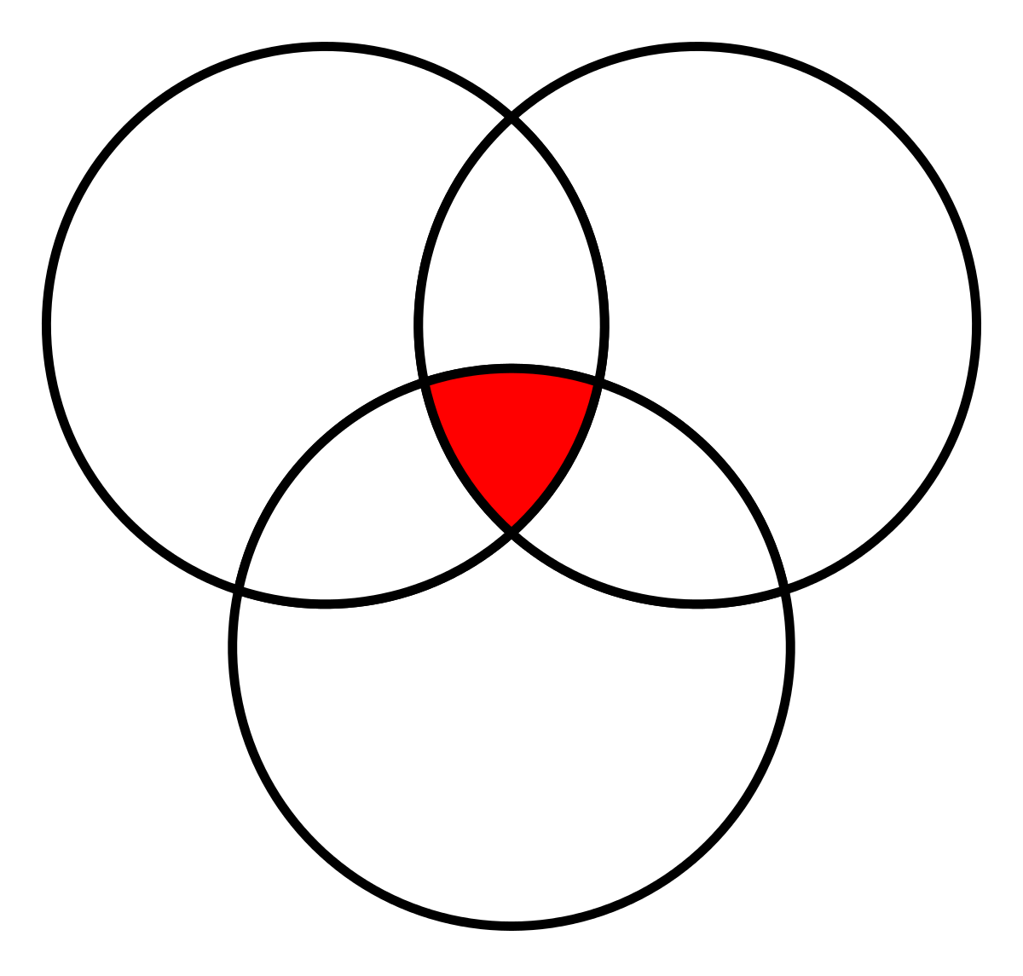


* Zones can overlap, but do not share any program
mandates, legal or funding requirements, or benefits
Tourism
Zone
Opportunity
Zone
VATC.org/tourismzones
DHCD.virginia.gov/opportunity-zones-oz
Tourism
Improvement
District
https://civitasadvisors.com/resources/research/tourism-improvement-district
15
Notes:
Tourism Zones can overlap with Virginia Opportunity Zones and other business zones, and do not share zone requirements and mandates
This includes the TIDs (Tourism Improvement Districts)
The newest of Virginia's tourism-related zone opportunities, TIDs authorize any a locality to create a local tourism improvement district plan, consisting of fees charged to visitors and used to fund tourism promotion activities and capital improvements
All TID funded initiatives follow the a plan, created by TID Governing Board, whose members are benefiting businesses
Visit > CIVITAS Advisor’s TIDs webpage for a deeper dive into TIDs and contact Tiffany Gallagher tgallagher@civitasadvisors.com

Slide 29
VISITORS

Slide 30
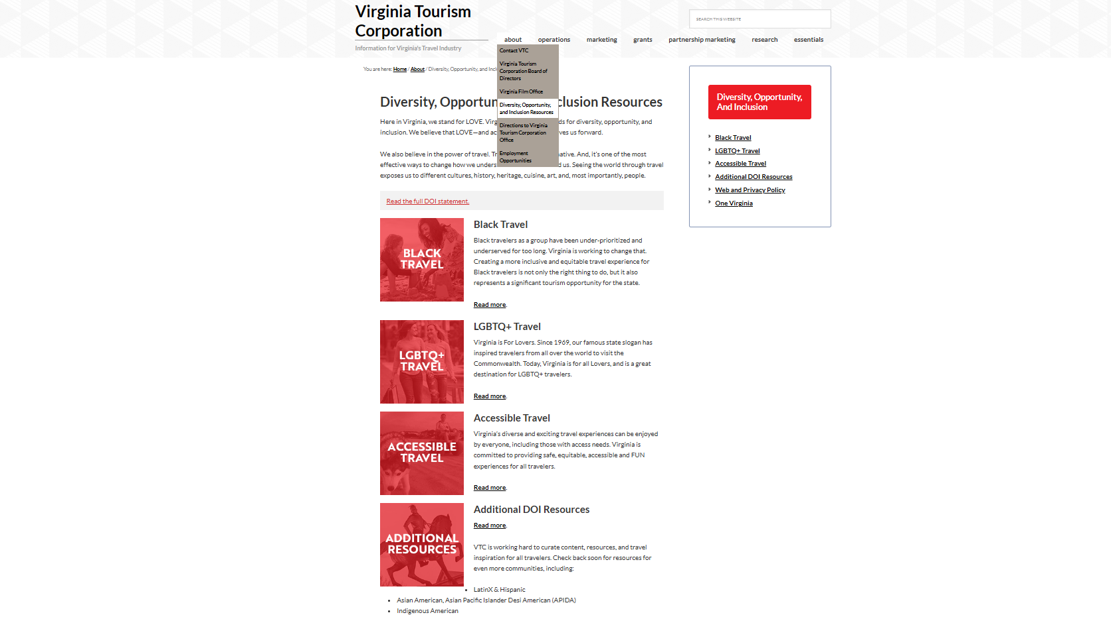
VISITORS
Click icon for web link >
VATC.org/about/doi
Click icon for web link >
Notes:
VA Tourism is reaching and increasing travel from diverse groups of travelers
You’ll see where you can connect to our business resources for Black Travel, LGBTQ+ Travel and more
And, link to our consumer website and social media work towards this effort

Slide 31

CONTACT
Wirt Confroy
Director of Business Development
wconfroy@virginia.org
(804) 545-5552
16

