Slide 1
TDFP │Gap Financing Support
Tourism Zones
TID │Tourism Improvement Districts

Slide 2
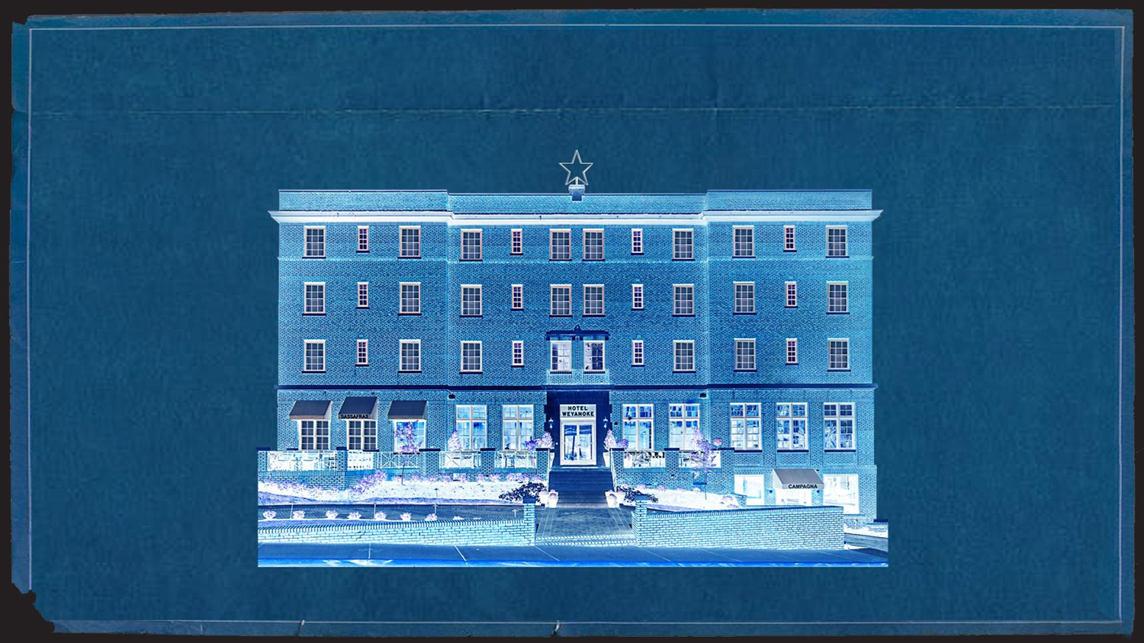
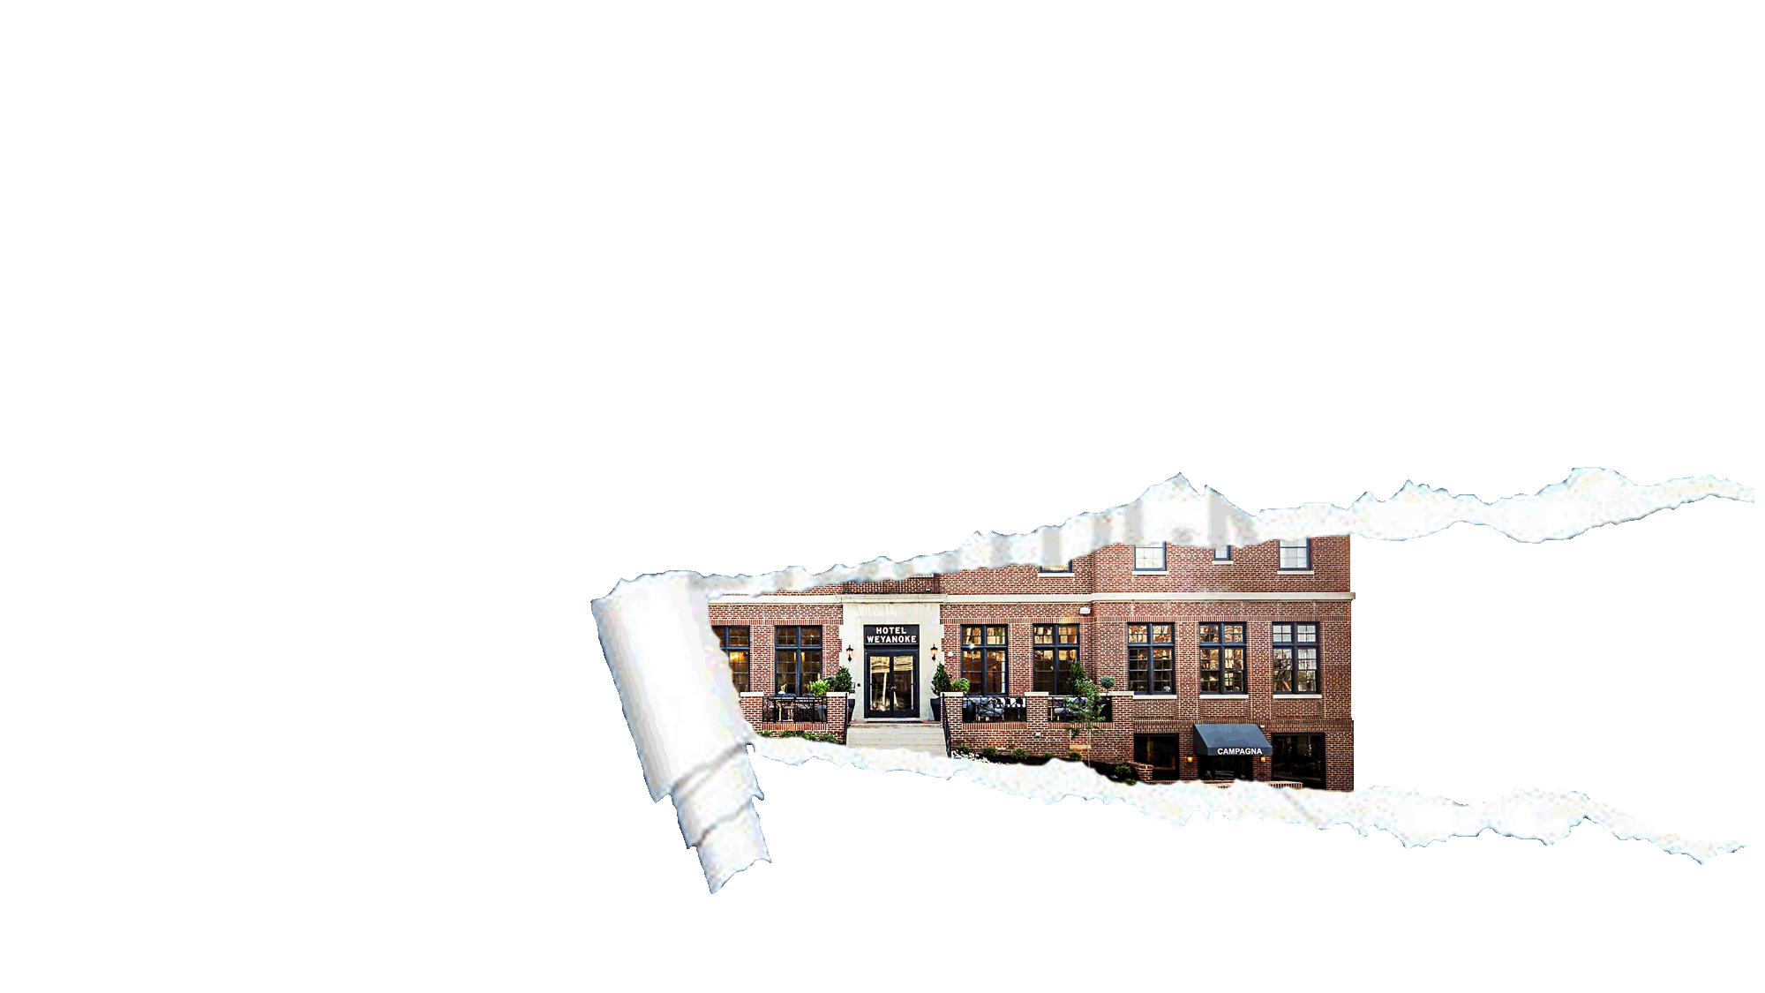
TOURISM DEVELOPMENT FINANCING PROGRAM

Slide 3
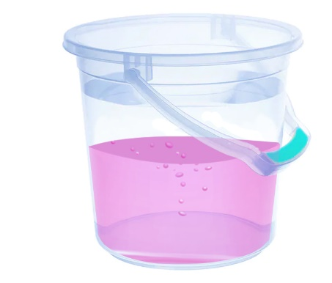
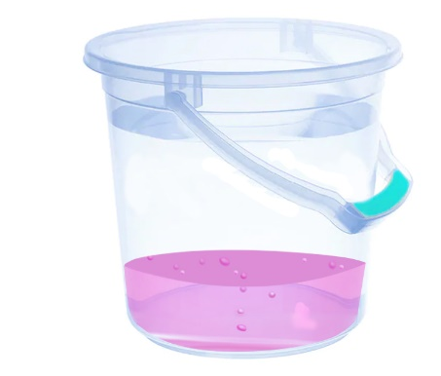
✔ Areas with High
Visitor Demand
X Areas with Med
Visitor Demand
X Areas with Low
Visitor Demand

Slide 4
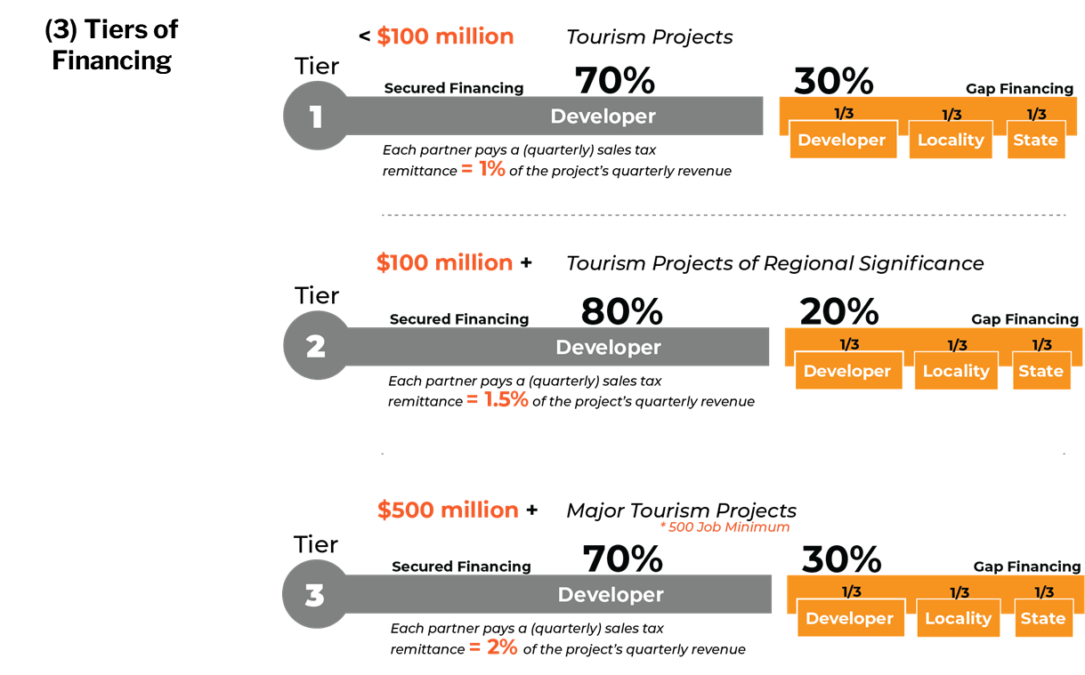
Notes:
Fredericksburg is a great example of a community who has fully taken advantage of tourism zones
They have 3 zones, all targeting different types of development

Slide 5
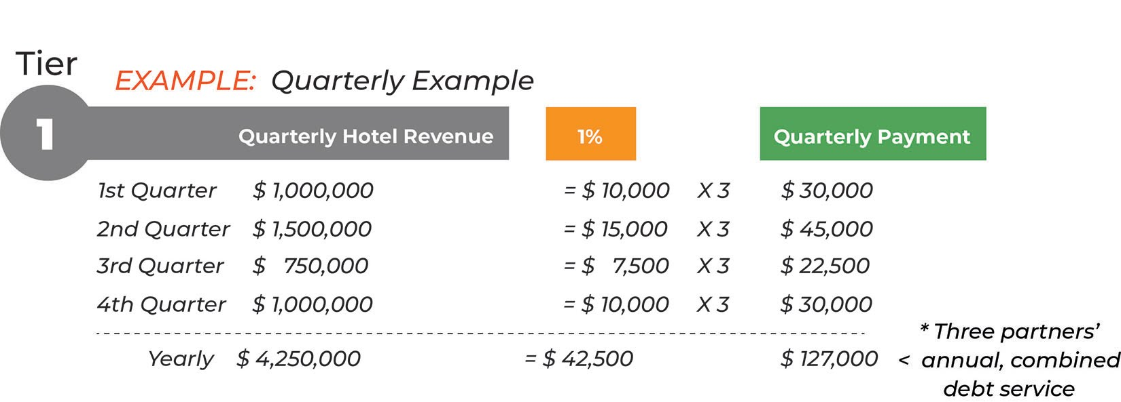
Example of
Quarterly
Payments
Notes:
Fredericksburg is a great example of a community who has fully taken advantage of tourism zones
They have 3 zones, all targeting different types of development

Slide 6
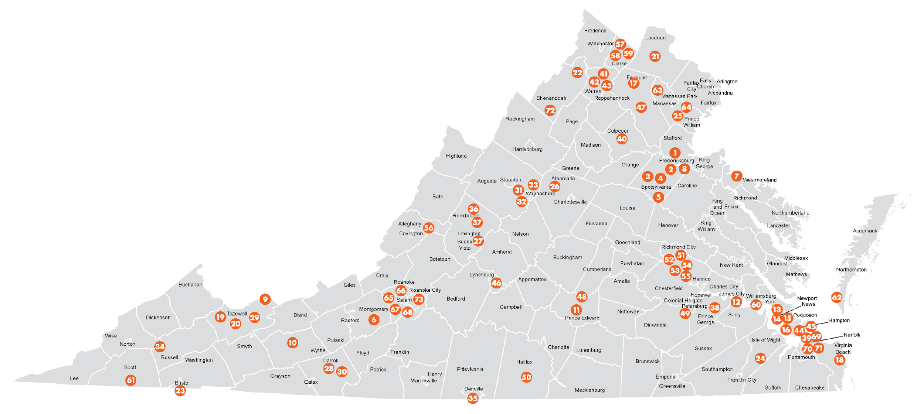
Tourism Zones in Virginia
VATC.org/tourismzones
Notes:
I’m going to change gears here for a minute and talk zoning with you guys
I want to talk about tourism zones, which area great tool for furthering tourism development in your community

Slide 7
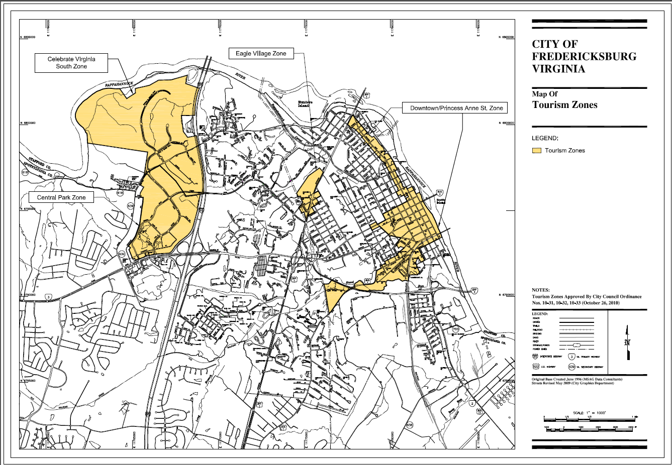
Notes:
Fredericksburg is a great example of a community who has fully taken advantage of tourism zones
They have 3 zones, all targeting different types of development

Slide 9
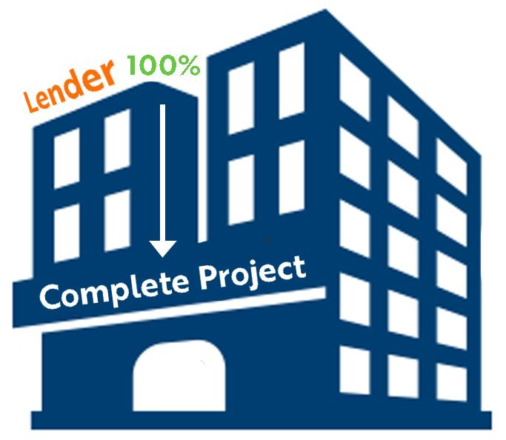
DEFICIENCY
Comprehensive Plan
Tourism Development Plan
Tourism Marketing Plan
Current Market Study
Tourism Zone
Much like
Tax Increment Financing
Municipality and State divert and contribute future sales tax revenues towards the Developer’s debt with the Lender

Slide 10
New Product
TDFP
Tourism Zones
Tourism Improvement Districts (TIDs)

Slide 11
TIDS
Tourism Improvement Districts
A business district created to increase revenue
for destination marketing & capital investment
Tourism businesses collect new visitor fees to
fund local tourism marketing & development

Slide 12
TIDS
Tourism Improvement Districts
Area hotels create a new visitor fee/tax
to use for marketing and development

Slide 13
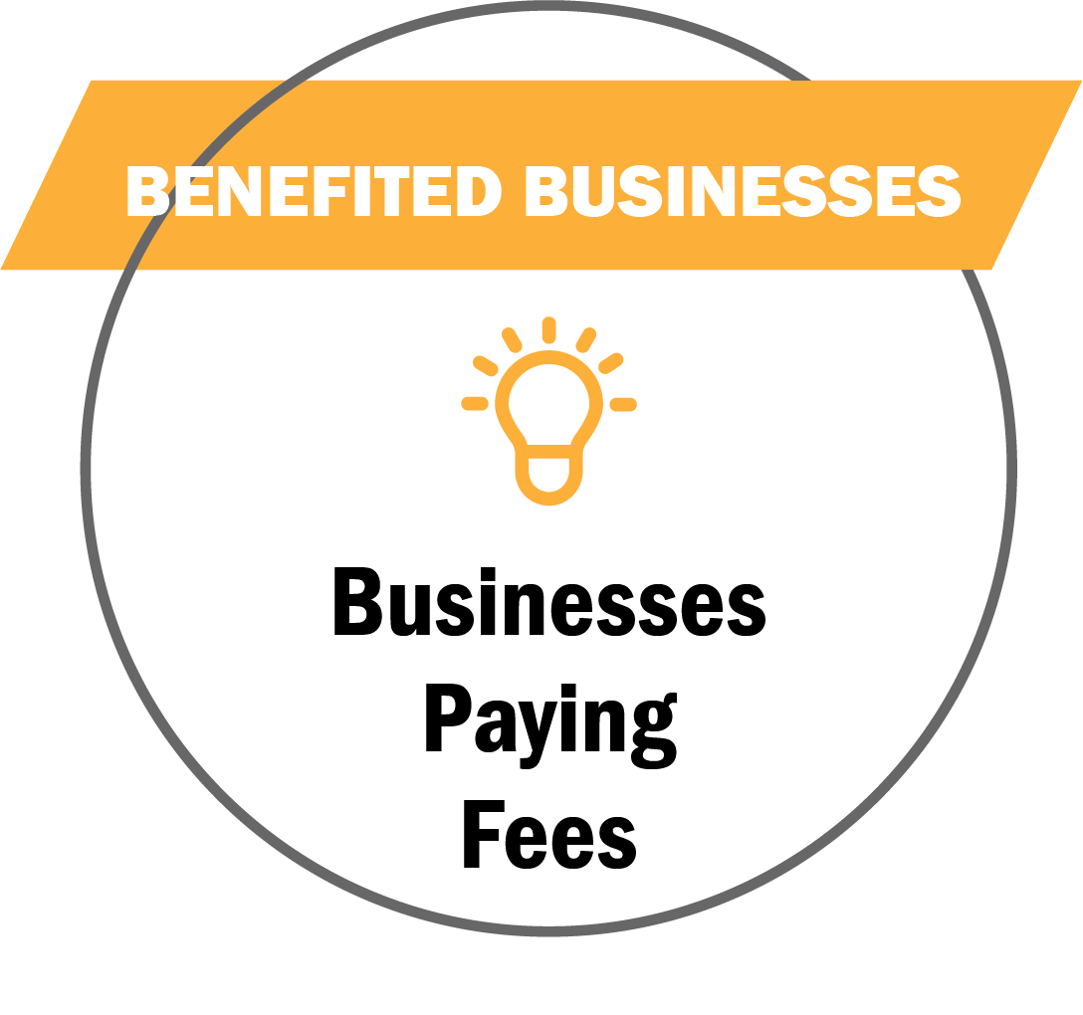
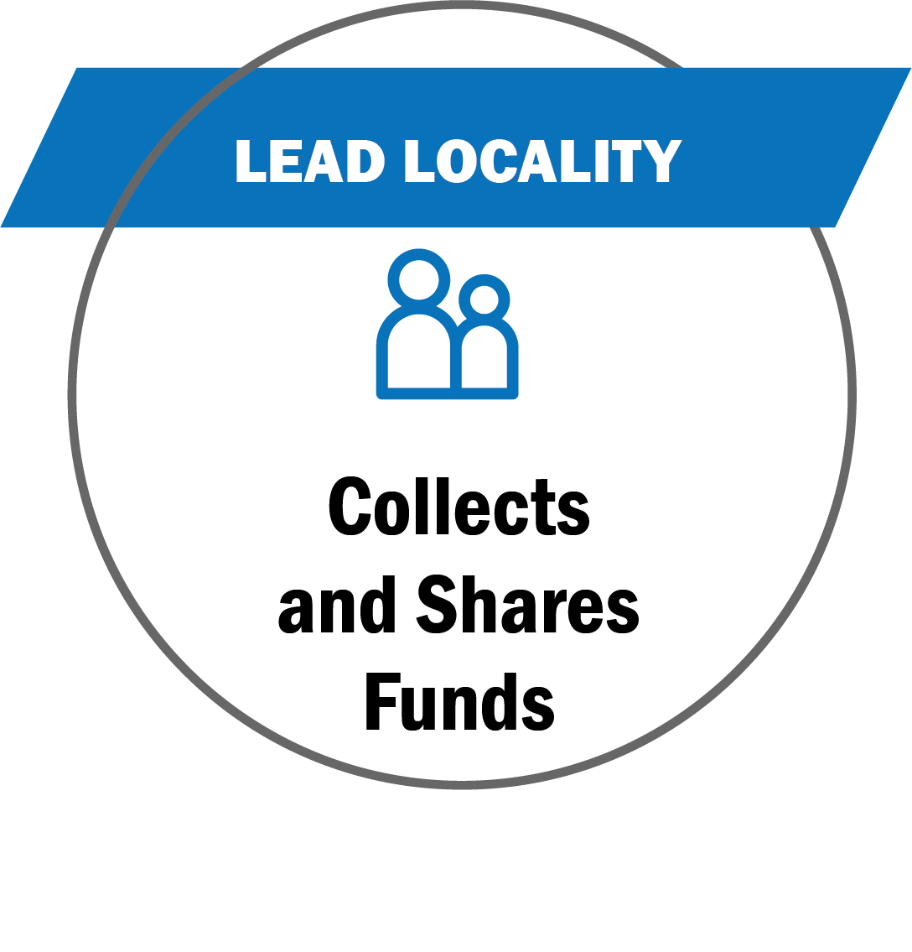
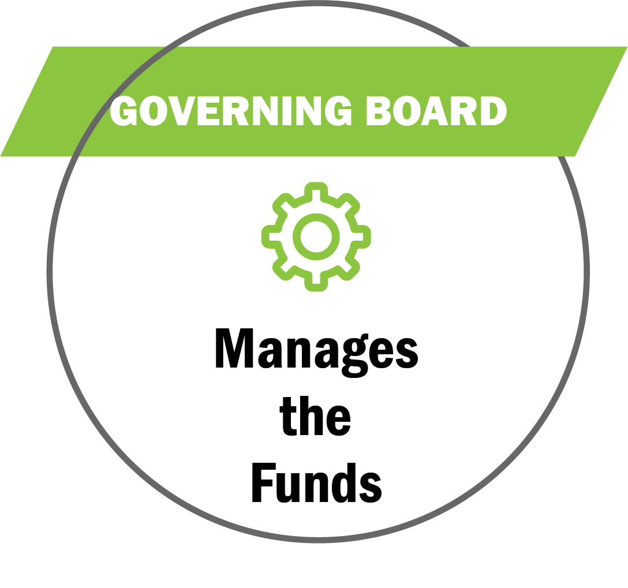
TIDs

Slide 14
TIDS
Benefited Businesses
Tourism Businesses
Initiates TID interest from local tourism businesses (hotels, restaurants,
attractions, etc.)
Collaborates with Locality to develop TID boundaries, eligibility, requirements and plan
Petitions Locality to create and adopt TID plan
Leading Locality
Municipality containing TID
Holds public hearings to review and adopt TID plan
Approves petition to create TID program
Collects fees and remits them to the TID Governing Board
TID Governing Board
Governing Board over TID Plan
Directs the funds received from the participating businesses
Executes the marketing efforts based on the adopted plan
Oversees any changes to the TID Plan
Creates more marketing dollars for local tourism efforts and campaigns
* Multiple localities can form
a regional TID

Slide 15
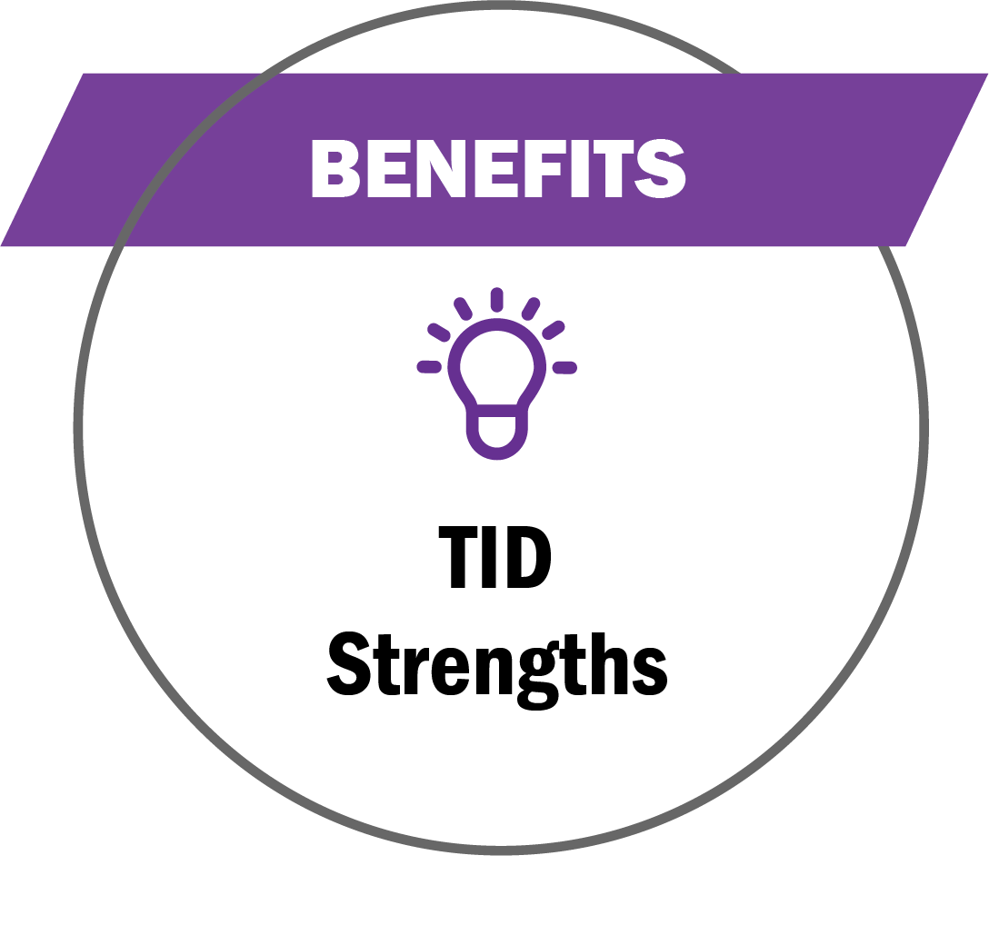
TIDS
Grow & Leverage Tourism Funding
Stable and fixed funding sources for marketing efforts
Industry-led and privately managed and approved by stakeholders
Existing funding protected and new funding stays with the industry
Designed to increase longer stays and more visitor spending
Accountability and transparency
Mitigate the harsh impacts COVID-19

Slide 16
TIDS
Fund Usage
Marketing, capital improvements, programming, workforce and DEI training
Sales site visits and events, group meeting incentives and bid fees, group commissions and rebates
Pay expenses to the Administering Nonprofit associated with the TID management and efforts

Slide 17
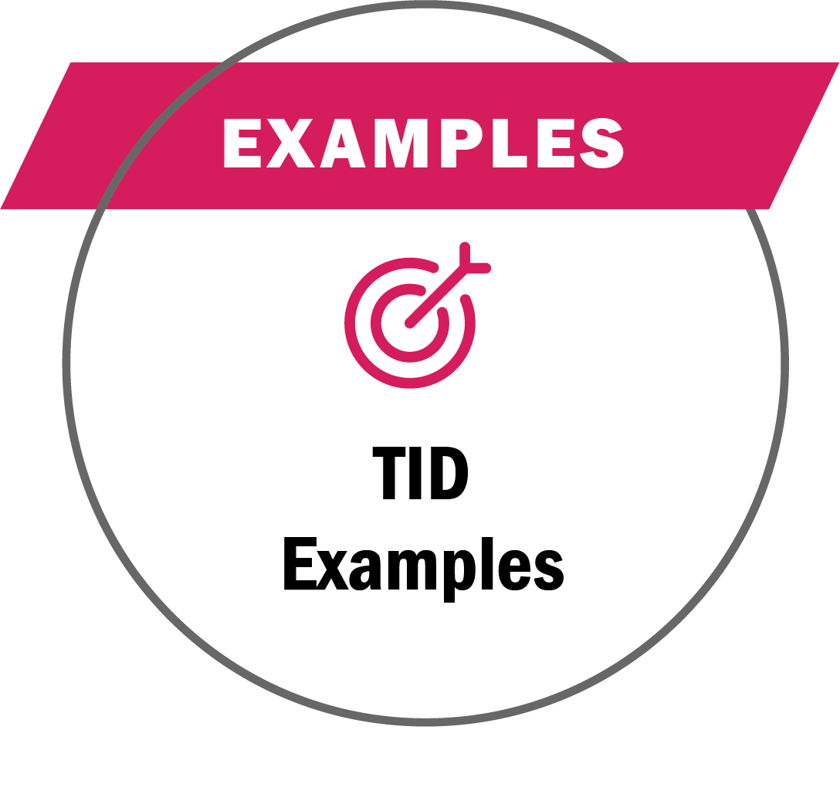
TIDS
Benefited Businesses
Funding Examples
Lodging 70+ rooms add 2% room/night tax
Eligible = advertising costs, agency fees, production, printing, distribution costs, training, travel, printed material, promotional items, information technology, market intelligence, research, & performance audits
Benefited Businesses
Funding Results
.75% on room daily rate
Achieved ROI of 8:1 for funds allocated
$5.6 Million collected in their first year
92 Large conventions & events funded
Resulted in $1.6 Billion in economic impact

Slide 18
1 Zone
Different Businesses
Contribute
Lodging, dining, retail, sports, attractions
1 Zone
Specific Businesses
Contribute
Food, Beverage, Sports, Attractions
TIDs are primarily created with lodging (hotels) as the lead partners
They have the visitor spending levels and frequency to establish and collect new visitor fees
Other tourism business sectors such as dining, retail and attractions can contribute if the local business community is unified
Businesses representing specific tourism sectors can collaborate and petition for a TID
A TID plan with only lodging, wineries, distilleries, cideries; or, restaurants or certain types of attractions can be created
Those benefiting businesses would collaborate, create their TID zone boundaries and plan
Then, petition the local government to adopt and pass the
TID plan (as with the example above)
Notes:
To recap …
A locality can have 1 Zone ⏐ Different Businesses Contribute
TIDs are primarily created with lodging/hotels as the lead partners
They have the visitor spending levels and frequency to establish and collect new visitor fees
Other tourism business sectors such as dining, retail and attractions can contribute if the local business community is unified
A locality can have 1 Zone ⏐ Specific Businesses Contribute
Businesses representing specific business sectors can collaborate and petition for a TID
A TID plan with only lodging, wineries, distilleries, cideries; or, restaurants or certain types of attractions can be created
Those benefiting businesses would collaborate, create their TID zone boundaries and plan
Then, petition the local government to adopt and pass the TID plan (as with the example above)

Slide 19
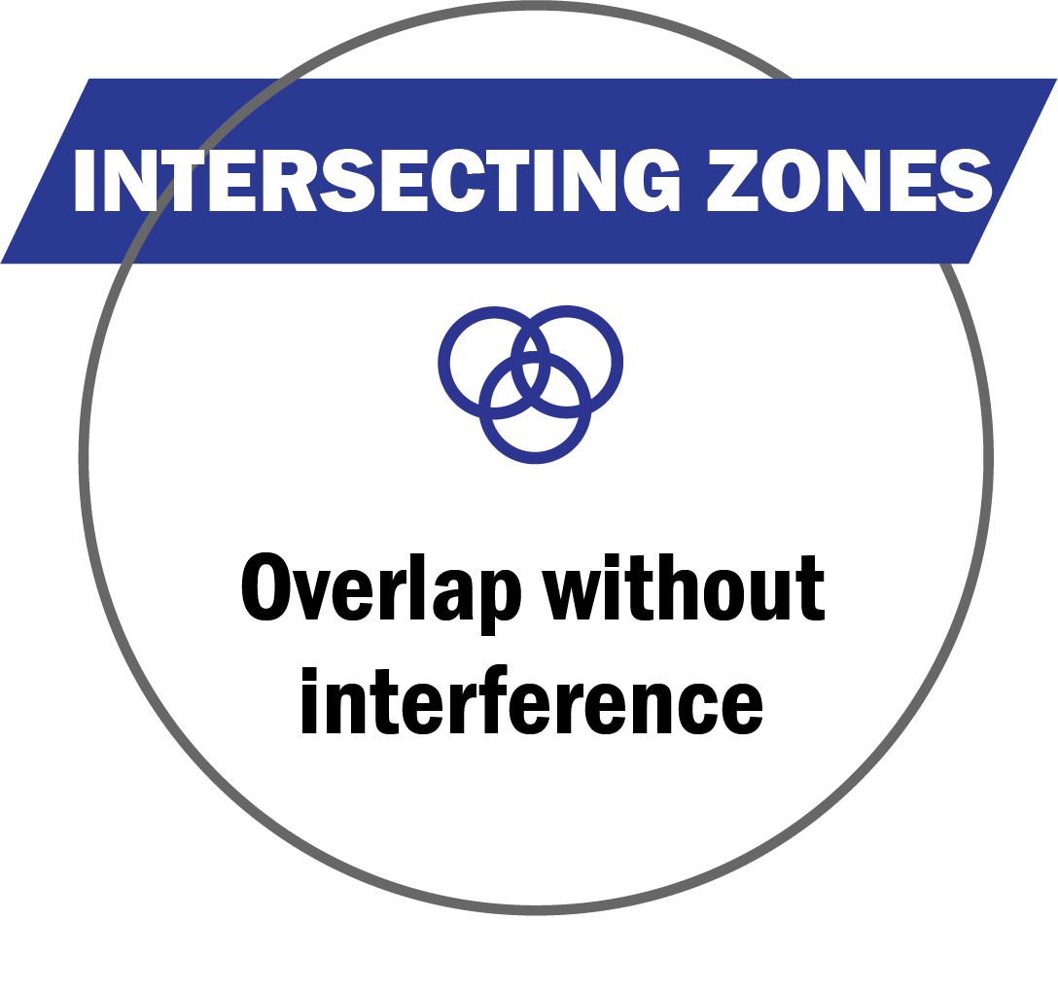
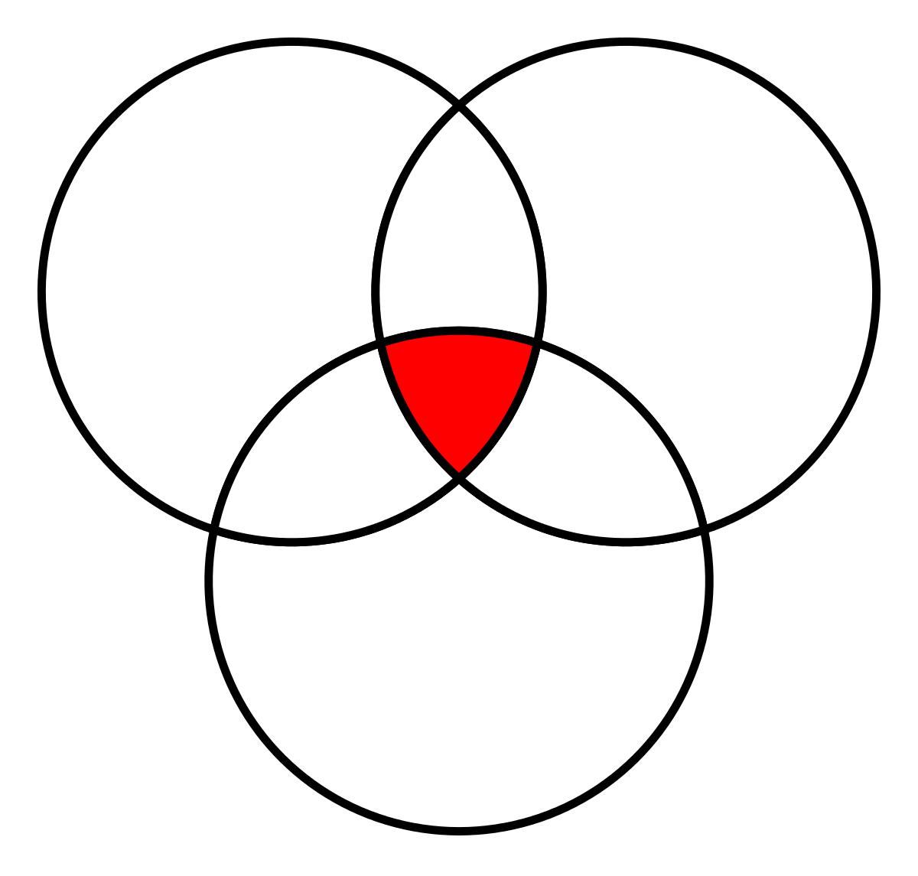
TIDS
* Zones can overlap, but do not share any program
mandates, legal or funding requirements, or benefits
Tourism
Zone
Opportunity
Zone
VATC.org/tourismzones
DHCD.virginia.gov/opportunity-zones-oz
https://civitasadvisors.com/resources/research/tourism-improvement-district
Tourism
Improvement
District
VRLTA
Eric Terry
eric@vrlta.org
CIVITAS Advisors
Tiffany Gallagher
tgallagher@civitasadvisors.com
15
Notes:
Tourism Zones can overlap with Virginia Opportunity Zones and other business zones, and do not share zone requirements and mandates
This includes the TIDs (Tourism Improvement Districts)
The newest of Virginia's tourism-related zone opportunities, TIDs authorize any a locality to create a local tourism improvement district plan, consisting of fees charged to visitors and used to fund tourism promotion activities and capital improvements
All TID funded initiatives follow the a plan, created by TID Governing Board, whose members are benefiting businesses
Visit > CIVITAS Advisor’s TIDs webpage for a deeper dive into TIDs and contact Tiffany Gallagher tgallagher@civitasadvisors.com

Slide 20
CONTACT
Wirt Confroy
Director of Business Development wconfroy@virginia.org
(804) 545-5552
16

