Slide 1
VTC
VA250 Tourism Marketing Program
August 2022

Slide 2
VA250 Tourism Marketing Program
First step in the VA250 initiative; partnership between VTC and the VA250 Commission
Designed to get localities forming committees and thinking about their VA250 and America’s 250th stories
Reimbursement grant program for marketing, including website design (but not maintenance)
We encourage localities to plan early and start scaffolding and phasing in programming over the next several years
.

Slide 3
VA250 Commission
Welcome Message
.

Slide 4
Applicant Information
Applicant must be a certified VA250 community committee
A copy of the locality resolution must be uploaded
There can only be ONE MAIN point of contact for this program
If the point of contact needs to change, please email us as soon as possible
.

Slide 5
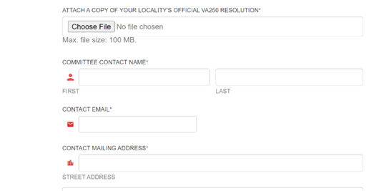
.

Slide 6
Program Focus
Name your program to reflect theme
Give a detailed description of your program
Program dates are needed; 18 months maximum
.

Slide 7
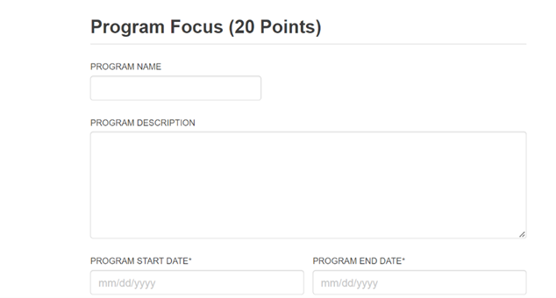
.

Slide 8
Program Focus
Articulate the goals of your program
Don’t assume the scorers will be familiar with your destination, attraction, or program
Explain your program direct connections to VA250 themes, quests for freedom, or stories related to American history, stories, or cultures.
.

Slide 9
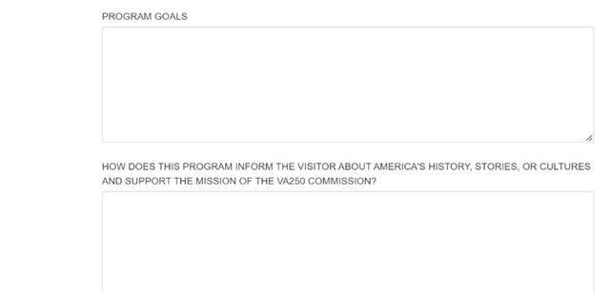
.

Slide 10
Program Focus/
Lasting Legacies
Explain how this program will tee up future VA250 and America’s 250 commemoration programming
Explain how deliverables will live on after the program end date and the 250th commemoration dates
Explain your program direct connections to VA250 themes, quests for freedom, or stories related to American history, stories, or cultures.
.

Slide 11
.

Slide 12
Partnerships
You will need two partners for this program that need to provide a letter of support
Partners must have a minimum $250 financial commitment to the program
Explain how you, along with your partners, will use this funding to drive overnight visitation
.

Slide 13
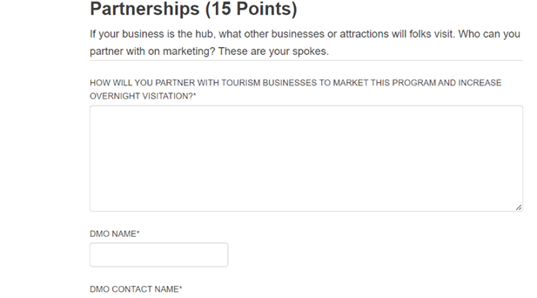
.

Slide 14
DMO Support
You will need a letter of support from your DMO
Talk to your DMO about planning for VA250 and America’s 250th
Work with your DMO to create a phased robust plan for VA250 and America’s 250th. This program will open twice a year for several years so you can create a scaffolded and phased program leading up to the commemoration.
.

Slide 15
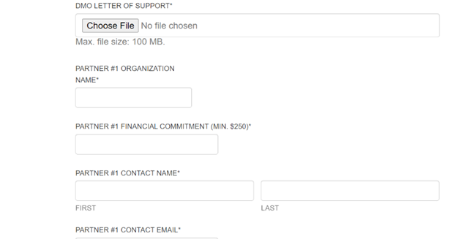
.

Slide 16
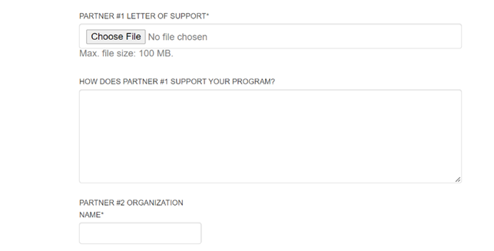
.

Slide 17
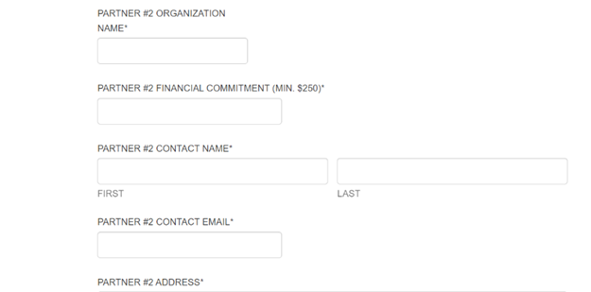
.

Slide 18
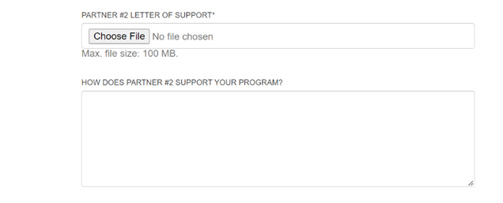
.

Slide 19
Cash Match Marketing Plan
This is your match. Money that you will be spending to support your program.
Use the drop down box to select the best option for your planned spending
You have ten lines to create your cash match marketing plan
You will need to submit evidence of this spending including invoices, proof of payment, and images.
.

Slide 20
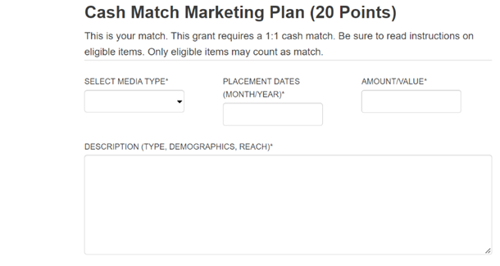
.

Slide 21
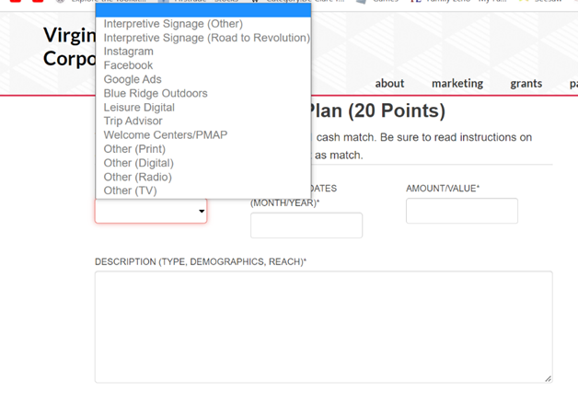
.

Slide 22
Check Your TOTALS!
.

Slide 23
Marketing Description
Thoroughly describe what you are spending money on
Indicate specific placement dates, media channels, and target demographics
Use research to justify your targets and marketing channels
.

Slide 24
Marketing Plan
This is marketing expenses that you want reimbursement for
Use the drop down box to select the best option for your planned spending
You have ten lines to create your marketing plan
You will need to submit evidence of this spending including invoices, proof of payment, and images.
.

Slide 25
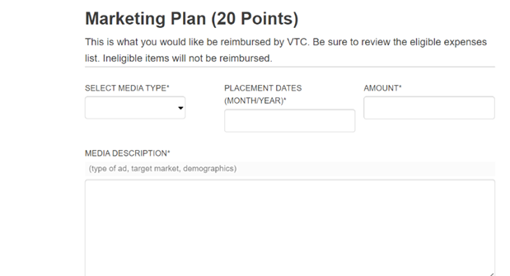
.

Slide 26
Marketing Description
Thoroughly describe what you are spending money on
Indicate specific placement dates, media channels, and target demographics
Use research to justify your targets and marketing channels
.

Slide 27
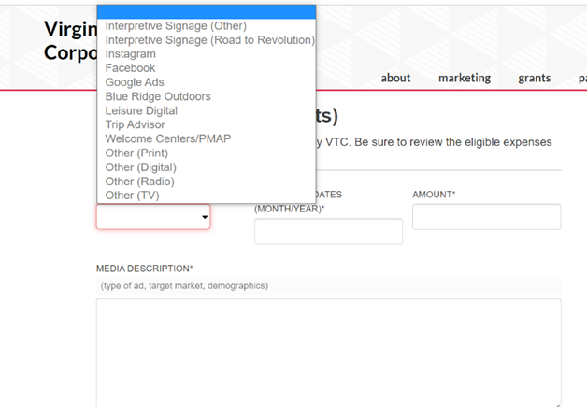
.

Slide 28
Check Your TOTALS!
Upload Sign Text!
.

Slide 29
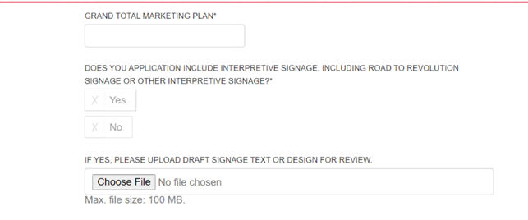
.

Slide 30
Performance Measures
Choose performance measures that work for your program
Slight increases are OK for this program
You must choose THREE Performance Measures
.

Slide 31
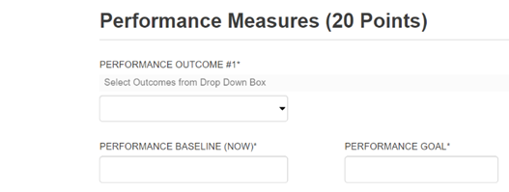
.

Slide 32
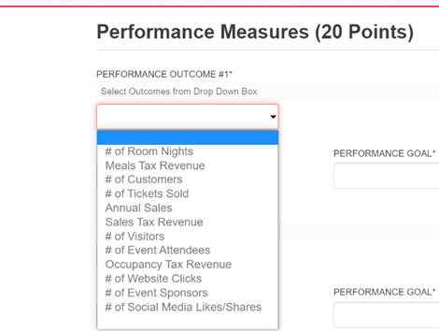
.

Slide 33
What if….
Indicate how this program will continue after the grant program dates
Indicate how you would continue this program if you only receive a partial award
.

Slide 34
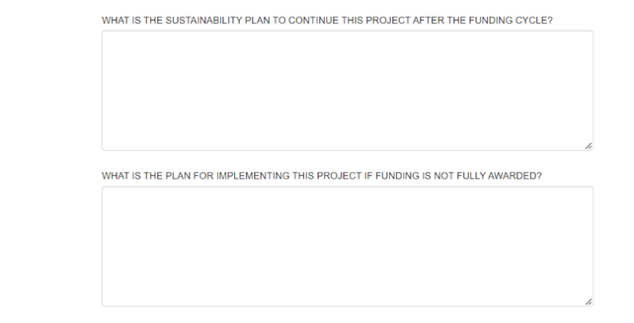
.

Slide 35
Activation–Bonus
You can earn bonus points
The Virginia is for Lovers Logo and VA250 logo are REQUIRED on your marketing materials for reimbursement
How will you go above and beyond that requirement?
.

Slide 36
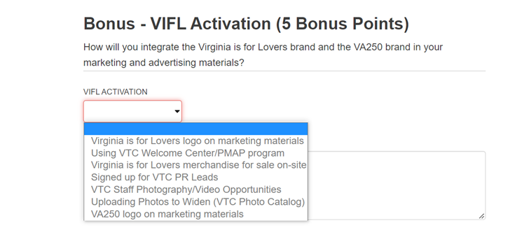
.

Slide 37
Submitting-Save the URL
SUBMITTING YOUR APPLICATION
VERY IMPORTANT:
· Your application information is saved on our server as you enter it.
· If you need to leave the application, scroll to the bottom of the application and click “Save and Continue Later”.
· You will receive a unique URL that will allow you to go back into the application to make edits. BE SURE TO COPY THIS URL SO THAT YOU CAN GO BACK TO EDIT YOUR APPLICATION!
· You also can enter your email address and have the link sent to you.
· You will need to follow this procedure each time you leave the application in order to save your work.
.

Slide 38
Submitting-Save the URL
Once you are ready to submit the Final Version, you will acknowledge the Acceptance of Terms.
· A SUBMIT button will appear
· At that point you may submit your application.
· You will receive a PDF of your application to the contact email address.
Please note that once you submit, you will NOT be able to make any revisions to your application.
.

Slide 39
DEADLINE INFORMATION
· Applications are due by 5:00 PM on Tuesday, January 24, 2023
· NO extensions to this deadline will be possible.
· Award announcements should be made by mid-April 2022

Slide 40
THANK YOU!
INSERT PRESENTATION TITLE HERE

