Slide 1
TIDS
Tourism Improvement Districts
A business district created to increase revenue
for destination marketing & capital investment
Tourism businesses collect new visitor fees to
fund local tourism marketing & development
1

Slide 2
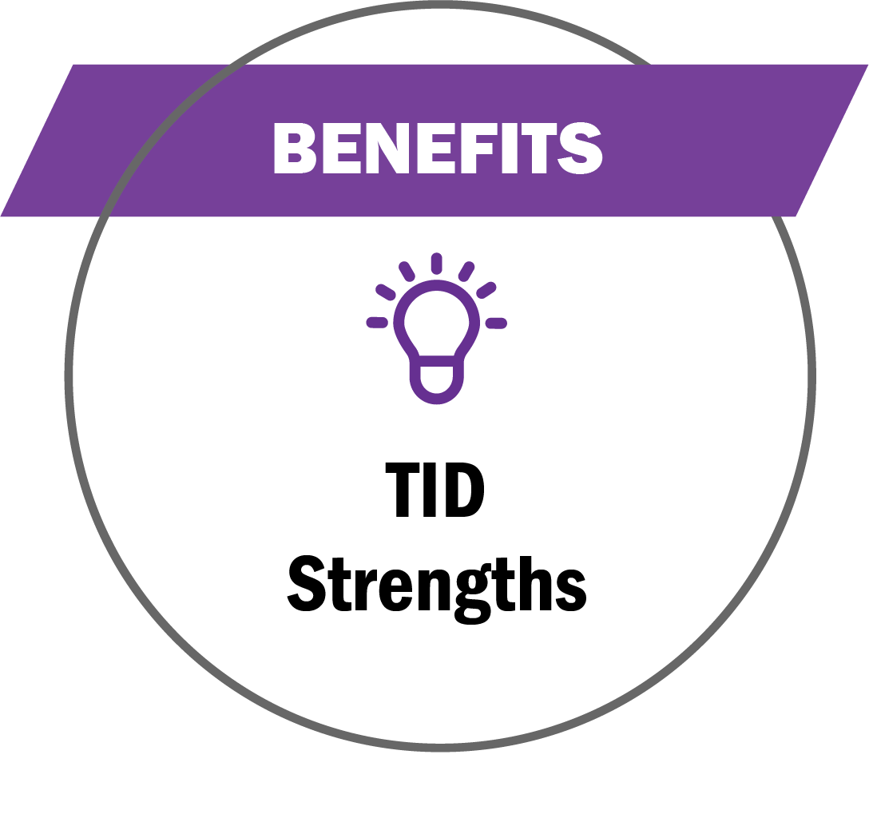
TIDS
Grow & Leverage Tourism Funding
Stable and fixed funding sources for marketing efforts
Industry-led and privately managed and approved by stakeholders
Existing funding protected and new funding stays with the industry
Designed to increase longer stays and more visitor spending
Accountability and transparency
Mitigate the harsh impacts COVID-19
2

Slide 3
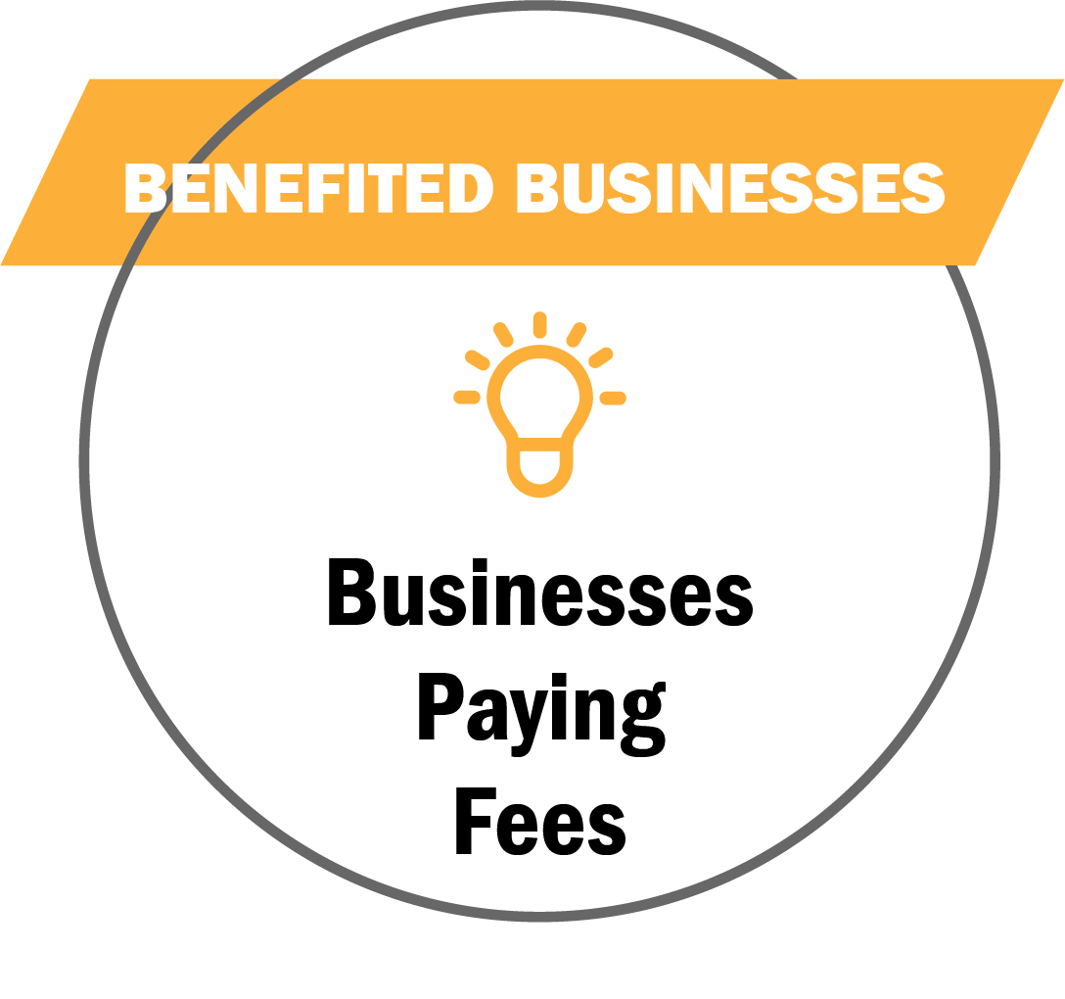
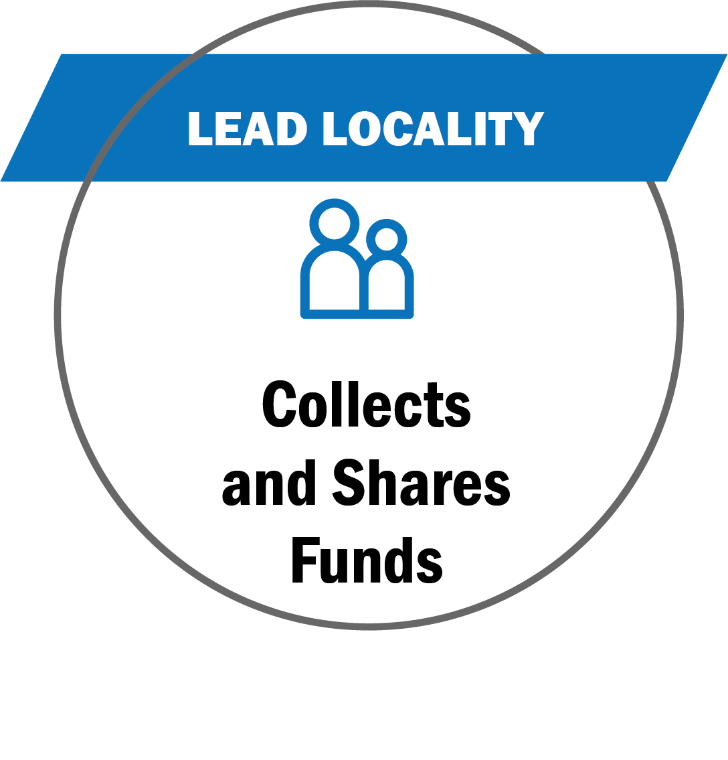
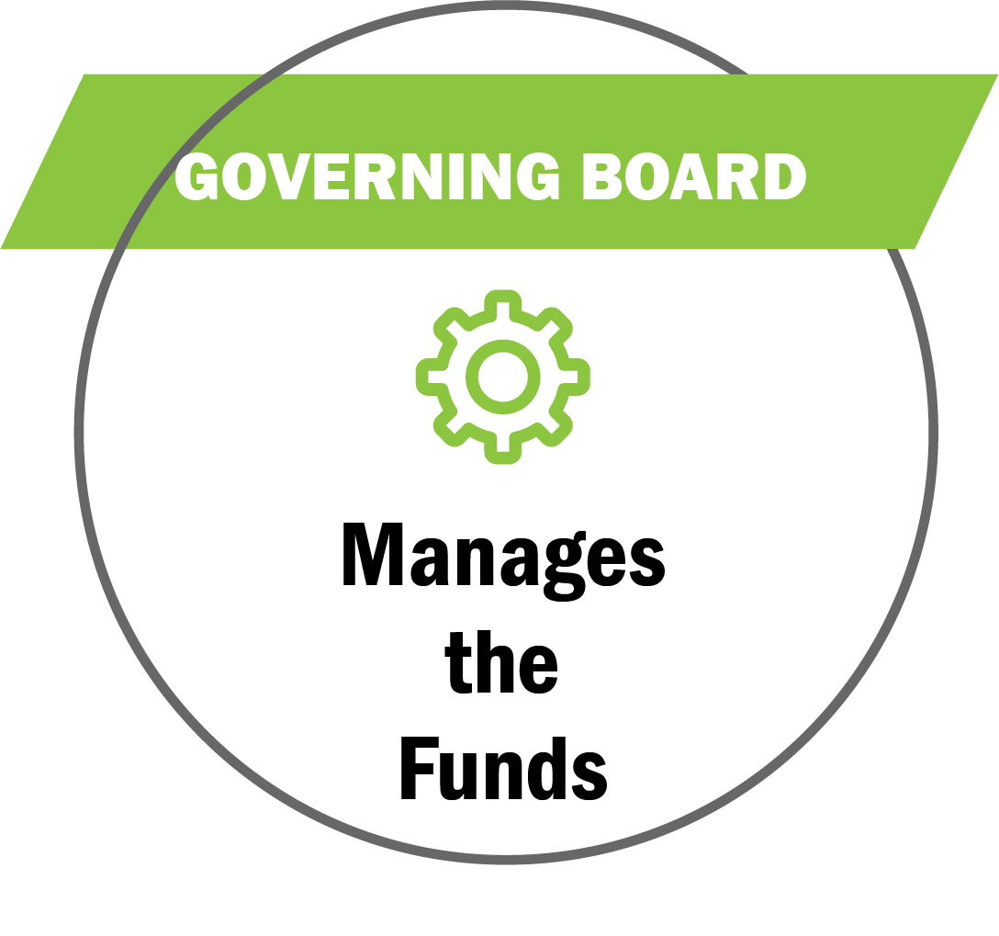
TIDs
3

Slide 4
TIDS
Benefited Businesses
Tourism Businesses
Initiates TID interest from local tourism businesses (hotels, restaurants,
attractions, etc.)
Collaborates with Locality to develop TID boundaries, eligibility, requirements and plan
Petitions Locality to create and adopt TID plan
Leading Locality
Municipality containing TID
Holds public hearings to review and adopt TID plan
Approves petition to create TID program
Collects fees and remits them to the TID Governing Board
TID Governing Board
Governing Board over TID Plan
Directs the funds received from the participating businesses
Executes the marketing efforts based on the adopted plan
Oversees any changes to the TID Plan
Creates more marketing dollars for local tourism efforts and campaigns
* Multiple localities can form
a regional TID
4

Slide 5
TIDS
TID Governing Board
The Governing Board engages a Nonprofit Administrator
The Administrator must be a private entity and not a public entity, nor may its board members or staff be considered public officials for any purpose
This can be an existing or newly created Nonprofit
5

Slide 6
TIDS
Fund Usage
Marketing, capital improvements, programming, workforce and DEI training
Sales site visits and events, group meeting incentives and bid fees, group commissions and rebates
Pay expenses to the Administering Nonprofit associated with the TID management and efforts
6

Slide 7
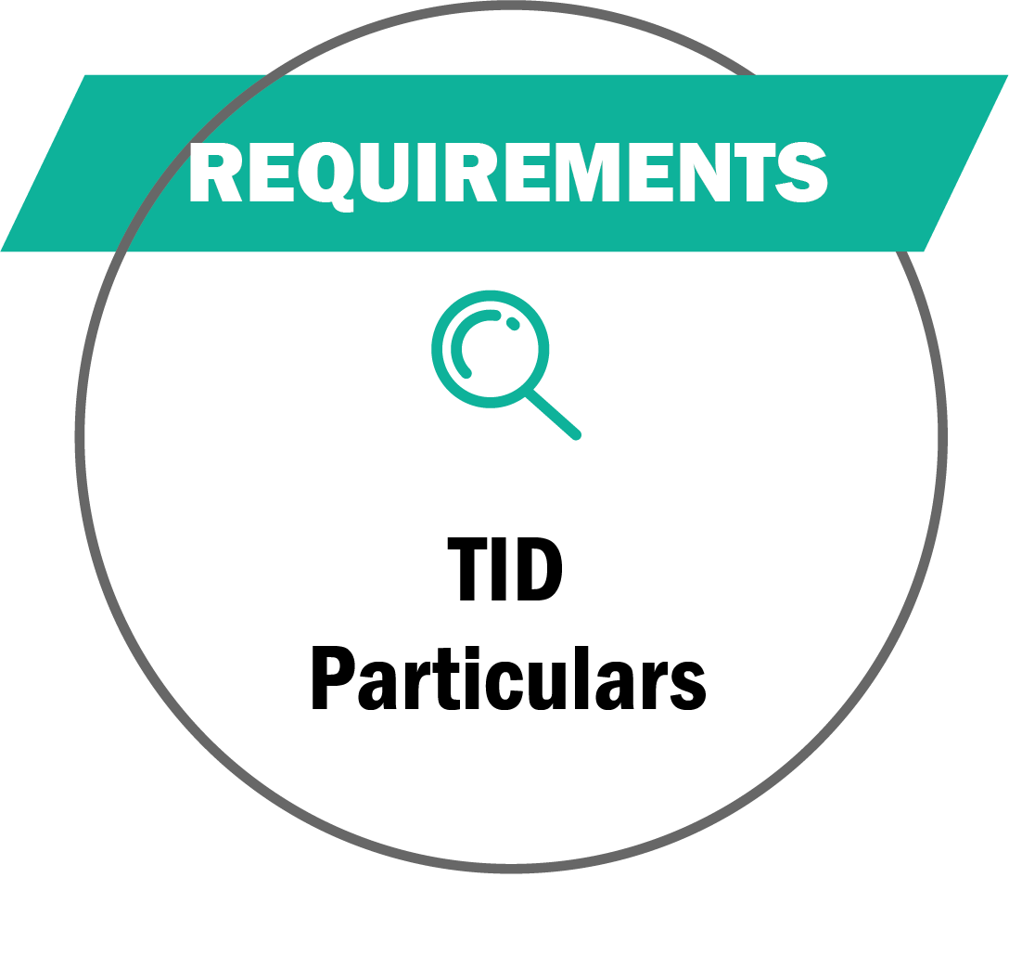
TIDS
TID Requirements & Definitions
No funds raised shall be used by the locality for any purposes other than the TID
Only plan-approved capital improvements are eligible for TID funds
In June 2021, the Code of Virginia was amended by adding TID
Chapter 24 of Title 15.2 an article numbered 3, consisting of
sections numbered 15.2-2413.1 through 15.2-2413.11
7

Slide 8
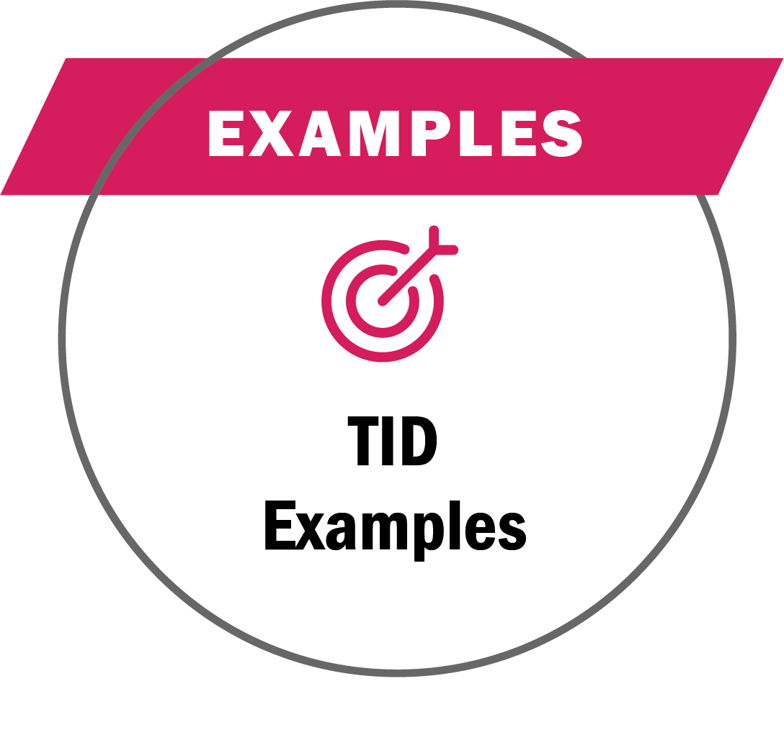
TIDS
Benefited Businesses
Funding Examples
Lodging 70+ rooms add 2% room/night tax
Eligible = advertising costs, agency fees, production, printing, distribution costs, training, travel, printed material, promotional items, information technology, market intelligence, research, & performance audits
Benefited Businesses
Funding Results
.75% on room daily rate
Achieved ROI of 8:1 for funds allocated
$5.6 Million collected in their first year
92 Large conventions & events funded
Resulted in $1.6 Billion in economic impact
8

Slide 9
1 Zone
Different Businesses
Contribute
Lodging, dining, retail, sports, attractions
1 Zone
Specific Businesses
Contribute
Food, Beverage, Sports, Attractions
TIDs are primarily created with lodging (hotels) as the lead partners
They have the visitor spending levels and frequency to establish and collect new visitor fees
Other tourism business sectors such as dining, retail and attractions can contribute if the local business community is unified
Businesses representing specific tourism sectors can collaborate and petition for a TID
A TID plan with only lodging, wineries, distilleries, cideries; or, restaurants or certain types of attractions can be created
Those benefiting businesses would collaborate, create their TID zone boundaries and plan
Then, petition the local government to adopt and pass the
TID plan (as with the example above)
Notes:
To recap …
A locality can have 1 Zone ⏐ Different Businesses Contribute
TIDs are primarily created with lodging/hotels as the lead partners
They have the visitor spending levels and frequency to establish and collect new visitor fees
Other tourism business sectors such as dining, retail and attractions can contribute if the local business community is unified
A locality can have 1 Zone ⏐ Specific Businesses Contribute
Businesses representing specific business sectors can collaborate and petition for a TID
A TID plan with only lodging, wineries, distilleries, cideries; or, restaurants or certain types of attractions can be created
Those benefiting businesses would collaborate, create their TID zone boundaries and plan
Then, petition the local government to adopt and pass the TID plan (as with the example above)

Slide 10
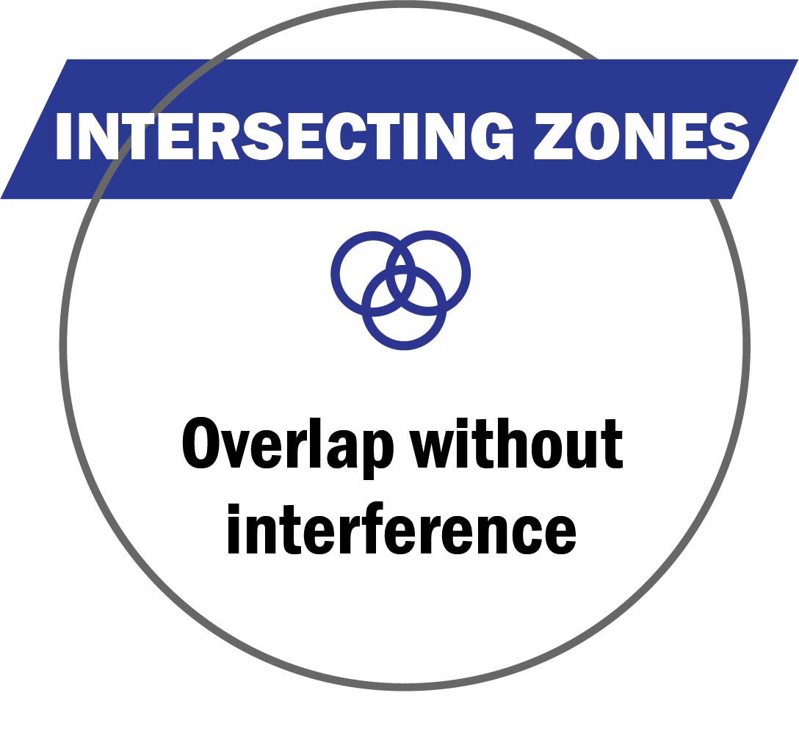
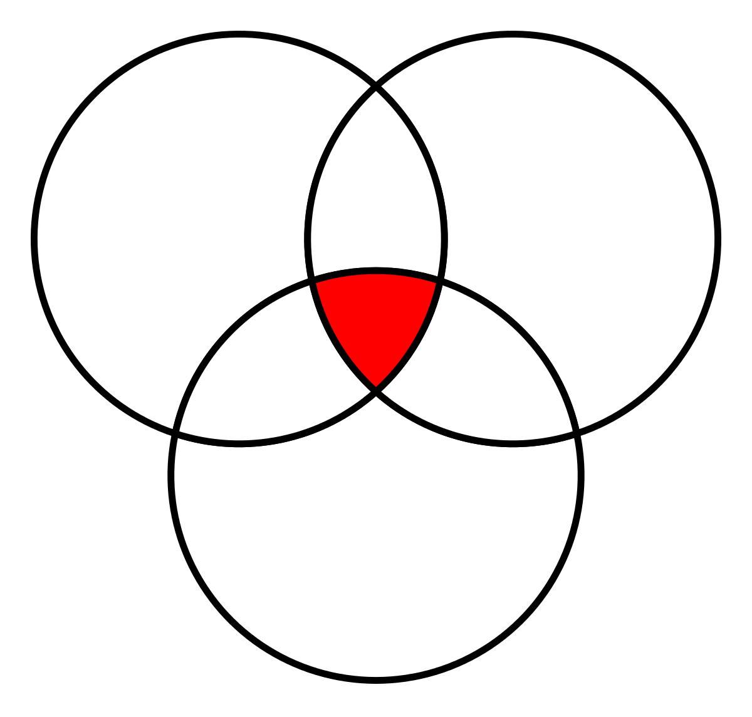
TIDS
* Zones can overlap, but do not share any program
mandates, legal or funding requirements, or benefits
Tourism
Zone
Opportunity
Zone
VATC.org/tourismzones
DHCD.virginia.gov/opportunity-zones-oz
https://civitasadvisors.com/resources/research/tourism-improvement-district
Tourism
Improvement
District
VRLTA
Eric Terry
eric@vrlta.org
CIVITAS Advisors
Tiffany Gallagher
tgallagher@civitasadvisors.com
15
Notes:
Tourism Zones can overlap with Virginia Opportunity Zones and other business zones, and do not share zone requirements and mandates
This includes the TIDs (Tourism Improvement Districts)
The newest of Virginia's tourism-related zone opportunities, TIDs authorize any a locality to create a local tourism improvement district plan, consisting of fees charged to visitors and used to fund tourism promotion activities and capital improvements
All TID funded initiatives follow the a plan, created by TID Governing Board, whose members are benefiting businesses
Visit > CIVITAS Advisor’s TIDs webpage for a deeper dive into TIDs and contact Tiffany Gallagher tgallagher@civitasadvisors.com

Slide 11
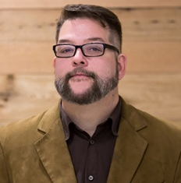
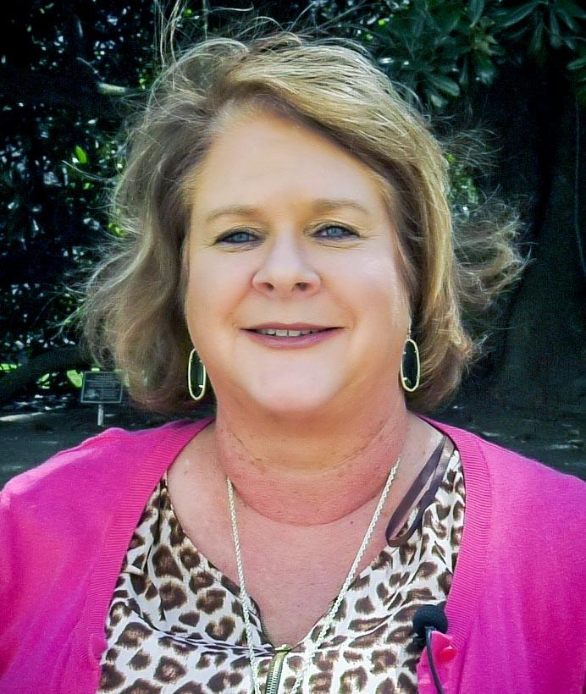
CONTACTS
VATC.org/TIDS
Wirt Confroy
Director of Business Development wconfroy@virginia.org
(804) 545-5552
Sandra Tanner
Destination Development Specialist stanner@virginia.org
(434) 757-7438
16

