Slide 1
VTC
Microbusiness Marketing Leverage Program (MMLP)

Slide 2
About the Program
Microbusiness grant round
Opens on August 4, 2022
Closes on September 20, 2022
Must apply in the online portal
No mailed applications will be accepted
No supplemental materials may be mailed
Max award: $5,000

Slide 3
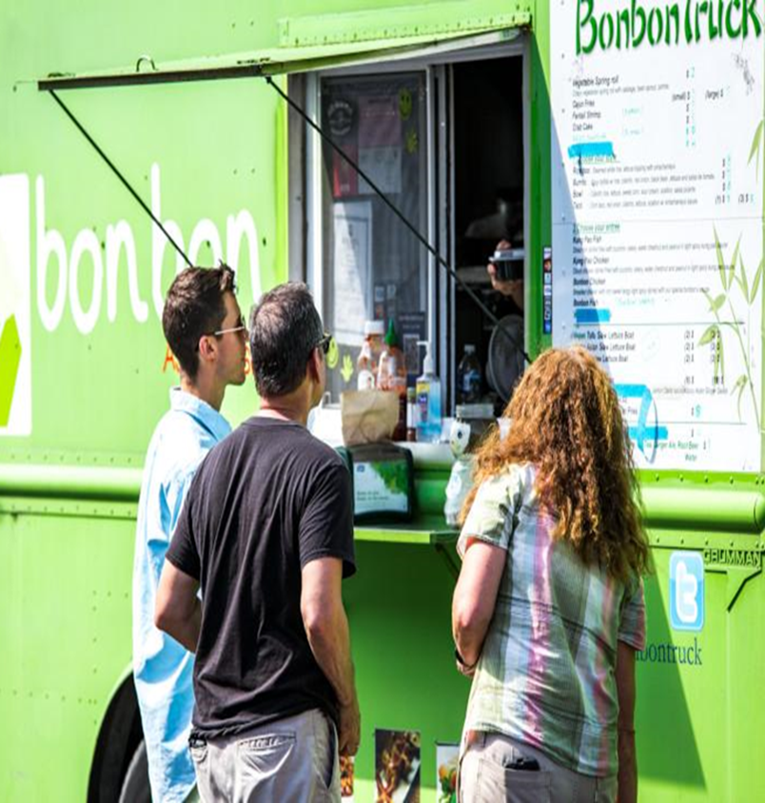
Who Can Apply?
Tourism-oriented small businesses that have 20 or fewer full-time equivalent employees.
Organizations that market small businesses like Chambers of Commerce
Marketing plan MUST focus on off-peak season travel

Slide 4
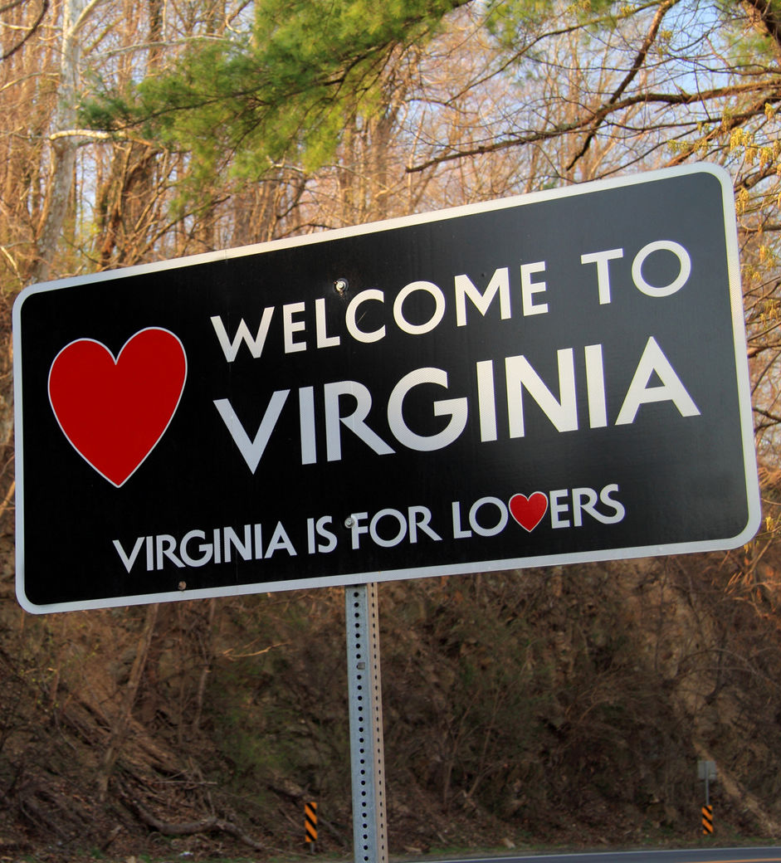
How to Apply
www.vatc.org/grants
Click Microbusiness Marketing Leverage Grant
READ the instructions documents
READ the Terms & Conditions
READ the FAQs

Slide 5
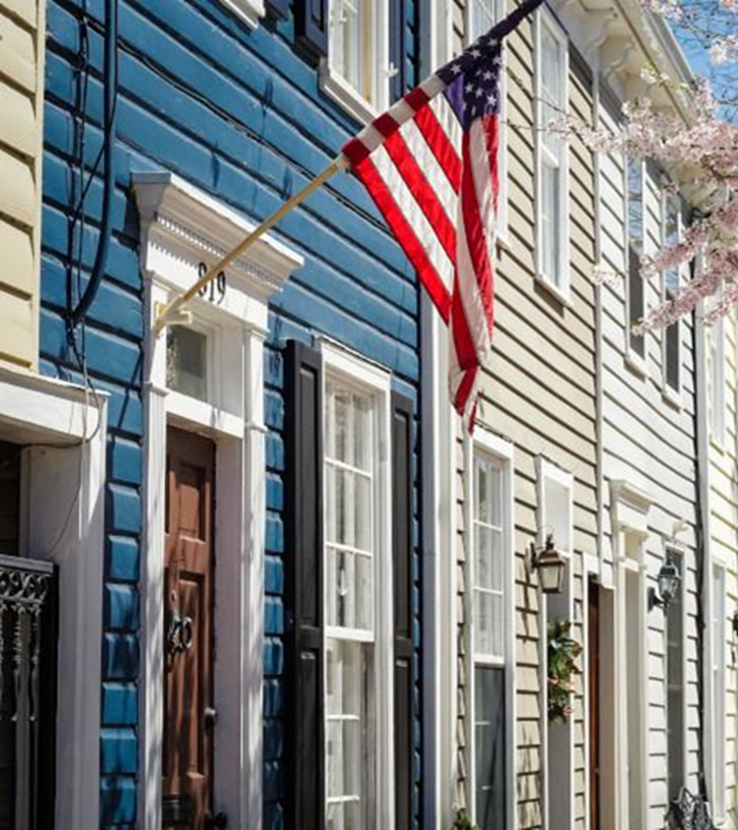
New in this application
Drop down boxes to collect data
Drop down boxes to help you focus on specific target markets and media outlets
Drop down boxes to help focus Bonus section
Limited to 7 line items in marketing plan---allocate funds carefully

Slide 6
Important Dates
Application closes September 20, 2022
Marketing plan expenditures must fall between June 1, 2022 and May 31, 2023
Award notification will be late October
Final reimbursements and reports due within 60 days of last expenditure and no later than August 31, 2023

Slide 7
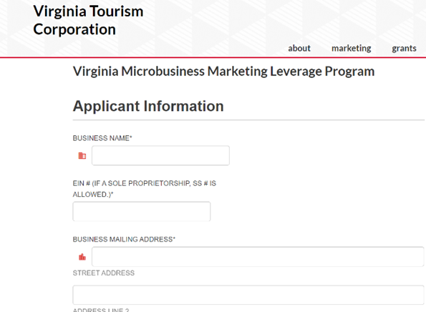
Application Portal
The Instructions document contains detailed information about each section.
Please answer all questions clearly and concisely.
Your EIN# or SS# if a sole proprietorship is required.
Businesses and organizations must be based in Virginia.

Slide 8
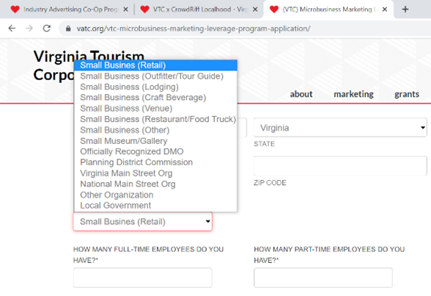
Business Type &
Employee Info
Select the choice that best fits the main aspect of your business or entity.
Enter the number of full-time employees you have and enter the number of part-time employees you have.
Detailed information on how to count full and part-time employees is in the instructions document.

Slide 9
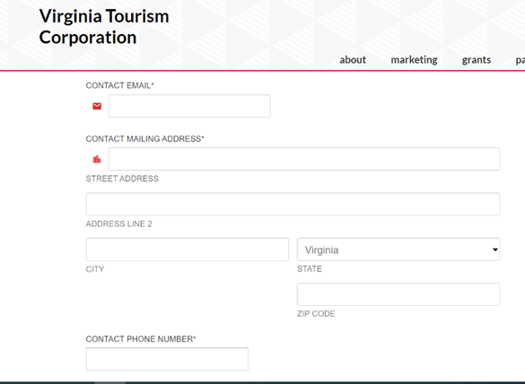
Contact Info
Identify the contact point for this program
VTC can not speak with anyone other than this person about your application
If phone numbers or addresses change, you must notify VTC in writing.

Slide 10
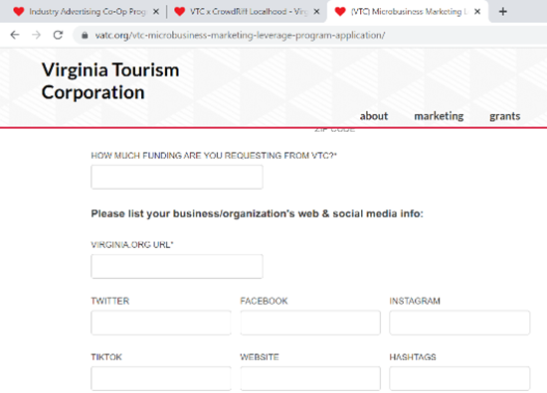
Funding Amount, Virginia.org, Social Media
List the amount of funding your are requesting from VTC
Max award is $5,000
List your Virginia.org listing url.
Being listed on Virginia.org is a requirement for this program.
List your social media handles

Slide 11
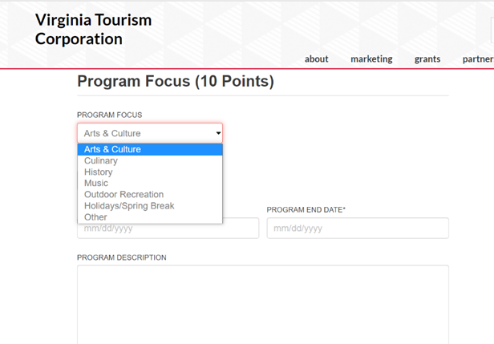
Program Focus
Select from the drop down the main focus of your marketing program
Select the dates of your program this can be as short as two weeks or as long as 12 months (June 1, 2022 to May 31, 2023)
We allow the lookback period since some folks are already placing fall advertising.
Provide a detailed description of your marketing program

Slide 12
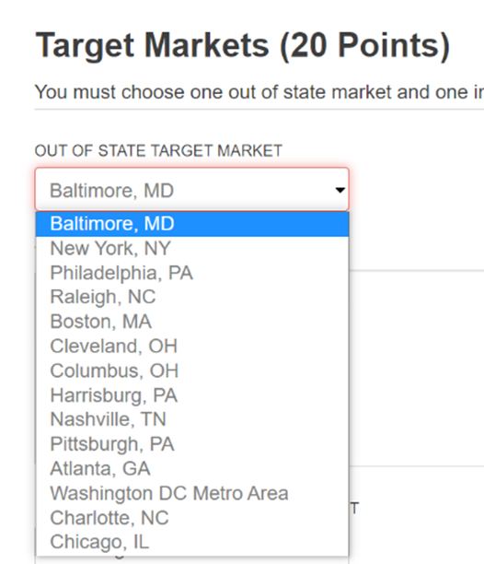
Target Market: Out-of-State
Select from the drop-down list ONE out-of-state target market
It must be from this list
You must allocate at least 25% (you can allocate more) of your request award to this marketing in your marketing plan
You can NOT select Washington D.C. as both your in-state and out-of-state market

Slide 13
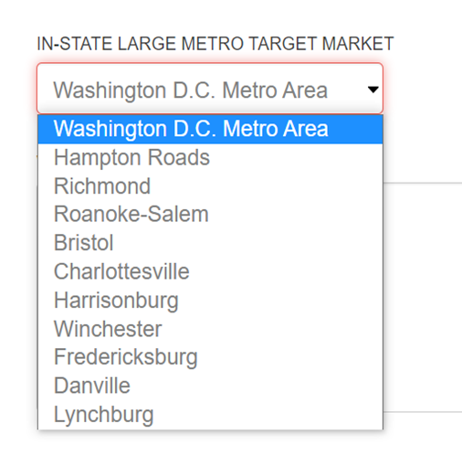
Target Market: In-State
Select ONE in-state target market from the drop-down box
These are major metro areas within Virginia and you must select one of these to target.
The goal of this program is to help you hyper focus on marketing in very specific markets

Slide 14
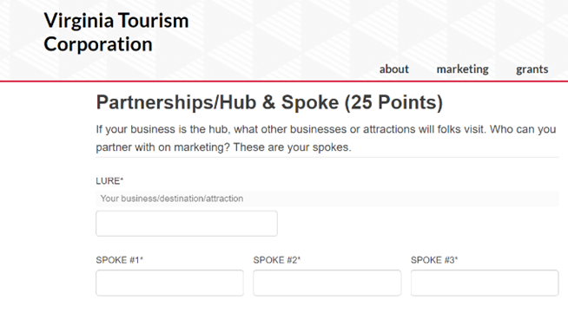
Partnerships
Hub & Spoke
VTC uses the Hub & Spoke model of partnership and marketing
Be sure to review your region’s Drive Tourism plan and the State Drive Tourism plan for information on the Hub & Spoke model
List your business as the Lure. If an organization, list a major attraction or destination as the lure. This is the hub of your hub & spoke.
Then list three other businesses that you can partner with on marketing.

Slide 15
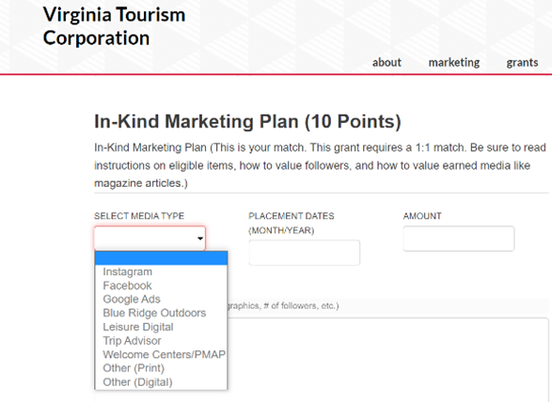
In-Kind Marketing
Match Plan
This is the section where you will list your in-kind match
This program requires a 1:1 match
Be sure to reach the Terms and Conditions on what counts as eligible marketing items as match and how to value any earned and owned media

Slide 16
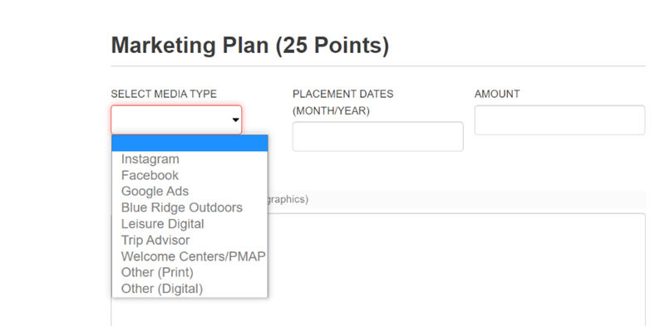
Marketing Plan
This is the most important section of your application
You have 7 lines to list your planned marketing expenditures
These must total at least the amount of funding you are request from VTC. You may list more.
Select media outlets from the drop-down box, list dates, amount, and description

Slide 17
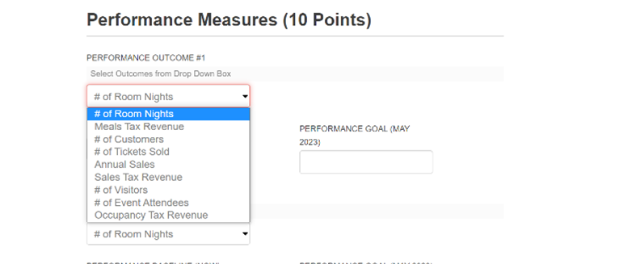
Performance Measures
Performance measures will help you track the effectiveness of your marketing efforts.
Make sure you select measures that you can easily look up and report out in your final report
You will select a performance measure. List where you are today and then list where you want to be in May 2023.

Slide 18
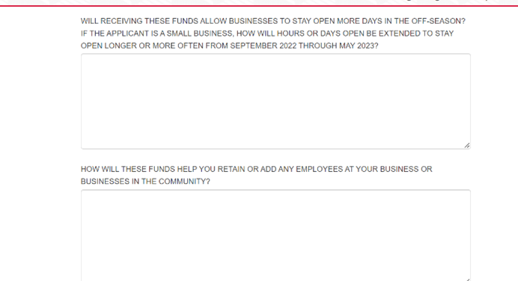
Performance Measures:
Business Impacts
Answer the two questions related to job creation, job retention, operating hours, and seasonal operations.
These are important so we know what kind of impact these funds will have in the small business ecosystem.

Slide 19
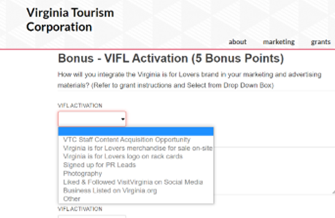
Bonus Section
Applicants can earn up to 5 bonus points by listing how they are or will engage with VTC.
The application instructions have descriptions of each of these line items.

Slide 20
AFTER YOU SUBMIT
Once you have completed your application and are ready to submit, you must accept the Terms and Conditions
You will be emailed a .pdf version of your application
Once you submit, you can not make changes to your application
Scoring will occur after September 21.
Awards will be made in late October

Slide 21
Questions?
Email: VTCMLPGrant@virginia.org
This mailbox is monitored daily by:
Noah Salaah ad-Deen, Grants Coordinator
Angela Wiggins, Grant Specialist
Staci Martin, Grants Manager
INSERT PRESENTATION TITLE HERE

